Slide 1
Evaluation and improvement of QoE and QoS parameters in commercial 5G networks: 5G-TOURS approach
ROMAN ODARCHENKO, DSc, professor
Chair of Telecommunication and radio engineering systems academic department
National aviation university, Kyiv, Ukraine
Senior researcher, State Research Institute of Cybersecurity Technologies
CEO of the Scientific Cybersecurity Association of Ukraine
October 26-27, 2023

Slide 2
Plan
Introduction
General information about 5G-TOURS project
General information regarding QoE and QoS estimation
QoE and QoS mapping
Proposed methodology

Slide 3
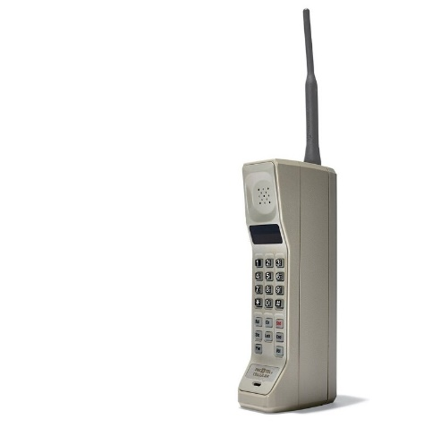
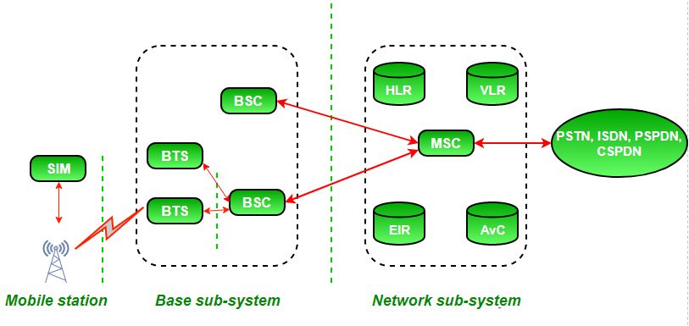
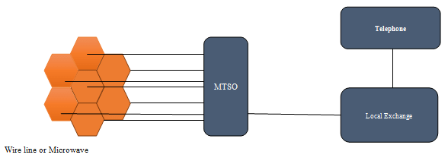
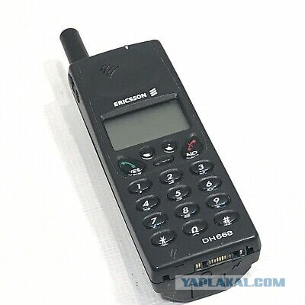
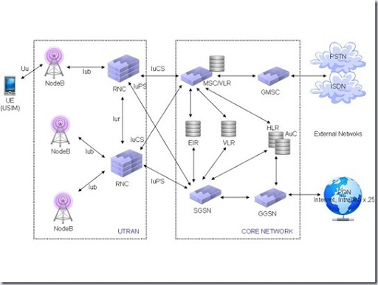
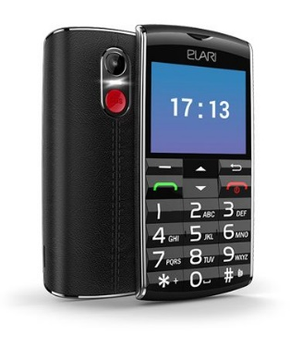
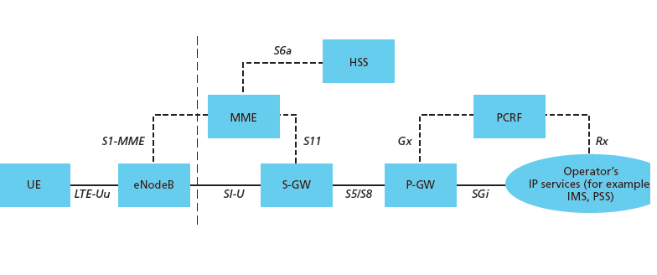
Development of cellular networks
1G: AMPS, TACS, NMT
2G: GSM, CDMA
…1946...
…1984…
…1990…
3G: WCDMA, UMTS
4G: LTE, WiMAX 2.0
…2002…
…2010…

Slide 4
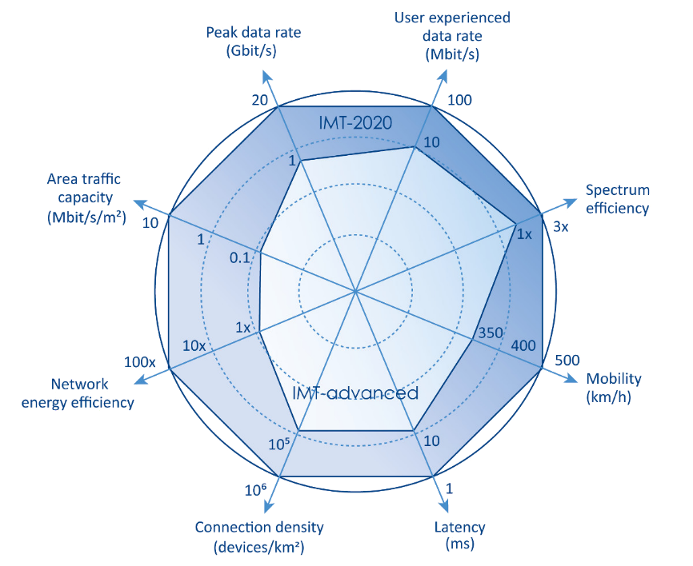
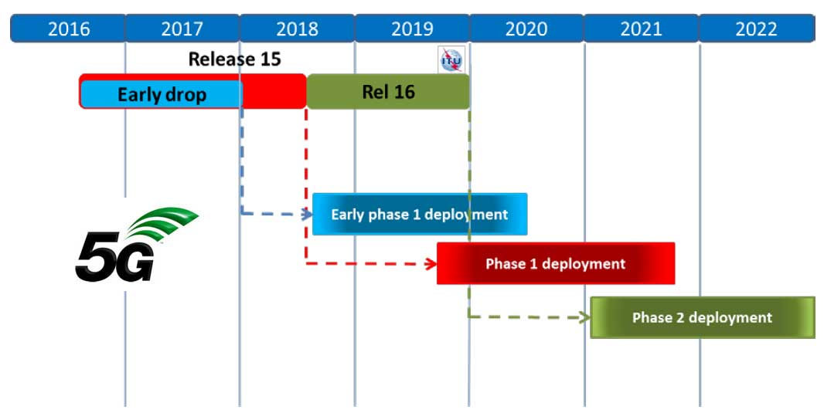
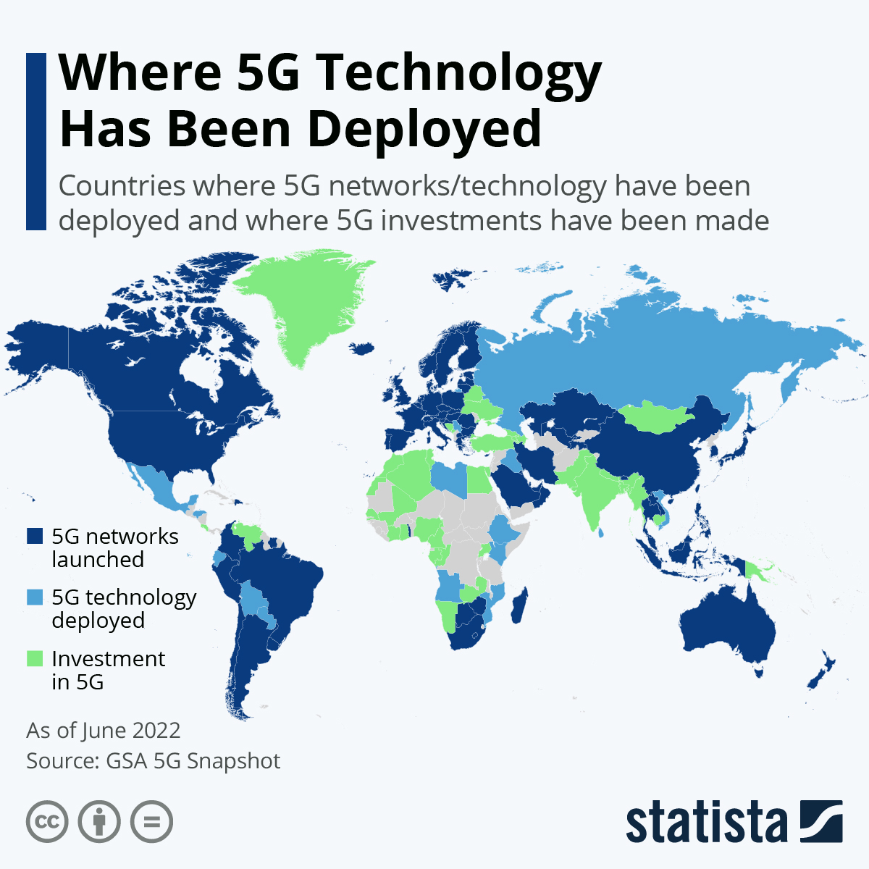
Current status of 5G
5G networks requirements
5G networks standardisation roadmap
5G networks deployments

Slide 5
GENERAL INFORMATION
Horizon 2020 – Call: | H2020-ICT-2018-2020
Topic: | ICT-19-2019 Advanced 5G validation trials across multiple vertical industries
Type of action: | R&I
Duration: | 36 Months
Start date: | 1/6/2019
Project Title: | 5G-TOURS: SmarT mObility, media and e-health for toURists and citizenS

Slide 6
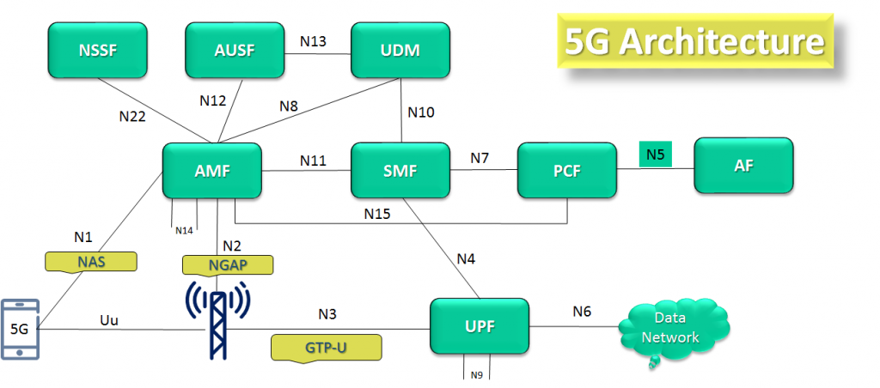
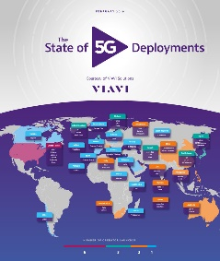
MOTIVATION
5G represents a paradigm shift from a horizontal service model to a vertical one where the services provided by the network are tailored to specific industry sectors and verticals. Most of the efforts conducted so far to evaluate 5G have focused on individual vertical use cases. 5G-TOURS aims to fill this gap by demonstrating the ability of 5G to support multiple vertical use cases concurrently on the same infrastructure.
Research of 5G technologies
5G architecture development
First 5G networks deployments
Verticals

Slide 7
VISION
5G-TOURS’ vision is to improve the life in the city for the citizens and tourists, making cities more attractive to visit, more efficient in terms of mobility and safer for everybody. The industry segments within this vision can greatly benefit from 5G technology and account for a very large fraction of Europe’s economy.

Slide 8
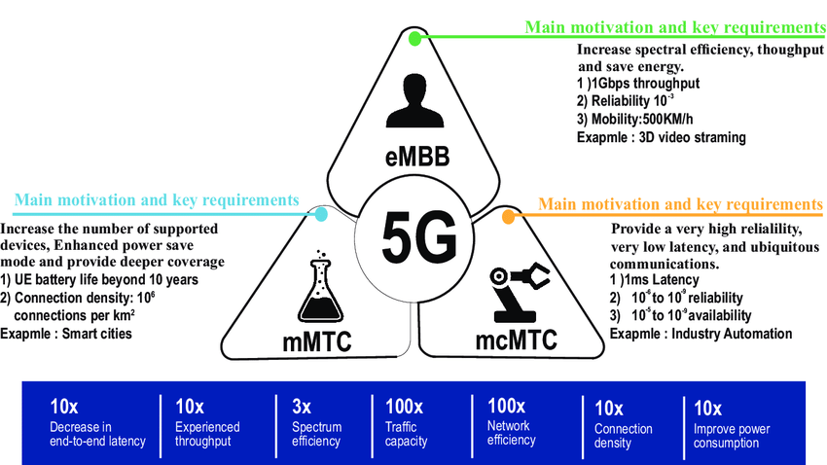
GOAL
The goal of 5G-TOURS is to get the European 5G Vision of “5G empowering vertical industries” [5GPPP16] closer to commercial deployment with highly innovative use cases involving cross-industry partnerships. 5G-TOURS addresses technological and business validation of 5G technology from two perspectives: (i) within the set of requirements specific from one application domain, and (ii) across all sets of heterogeneous requirements stemming from concurrent usages of network resources by different vertical domains.

Slide 9
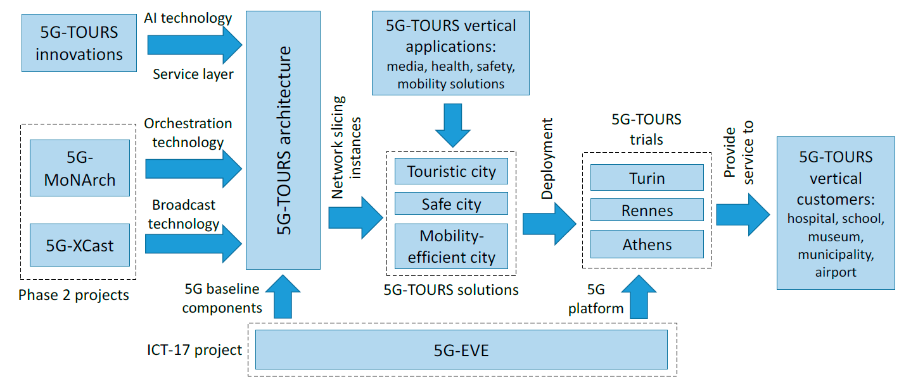
APPROACH FOLLOWED BY THE 5G-TOURS PROJECT

Slide 10
Tourin: The touristic city
The visitors of museums and outdoor attractions are provided with 5G-based applications to enhance their experience while visiting the city. This includes VR/AR applications to complement the physical visit with additional content, involving interactive tactile communications. The experience of the visitors is also enhanced with robot-assisted services, telepresence to allow for remote visits, as well as live events enabled by mobile communications such as multi-party concerts.

Slide 11
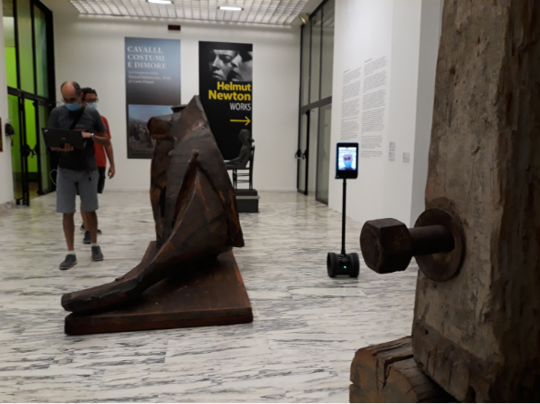
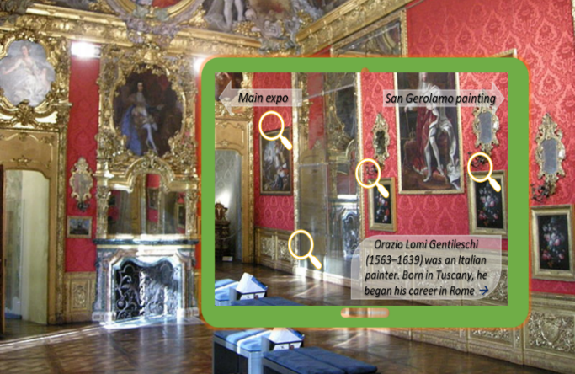
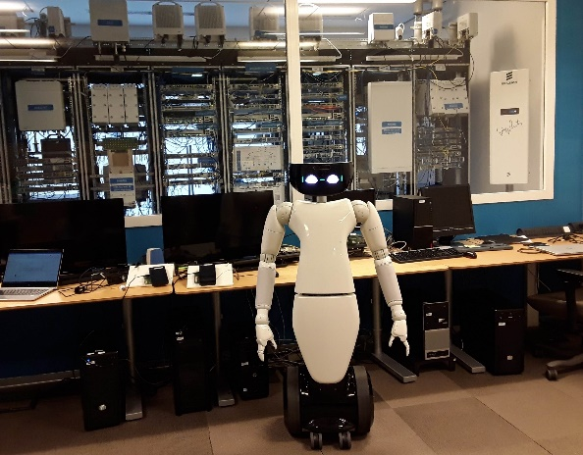
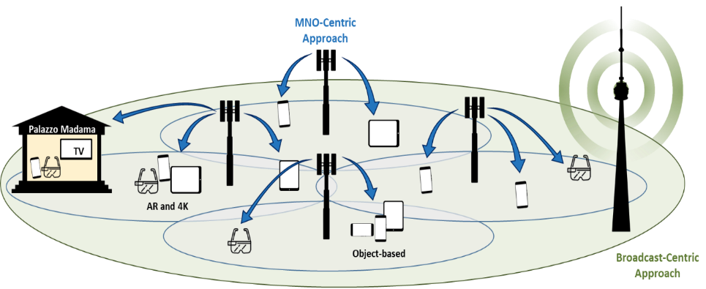
Tourin: The touristic city Use Cases
Telepresence
Augmented tourism
experience
Robot assisted
museum guide
High quality video services distribution
Remote and distributed video production

Slide 12
Athens: The mobility-efficient city
Mobility to reach and move inside the city is made more efficient and comfortable. This involves smarter cities, gathering information about the city and using it to improve navigation systems as well as parking. Traveling is also made more enjoyable, providing AR/VR services to passengers, and airports become logistically more efficient by relying on 5G for their operation.

Slide 13
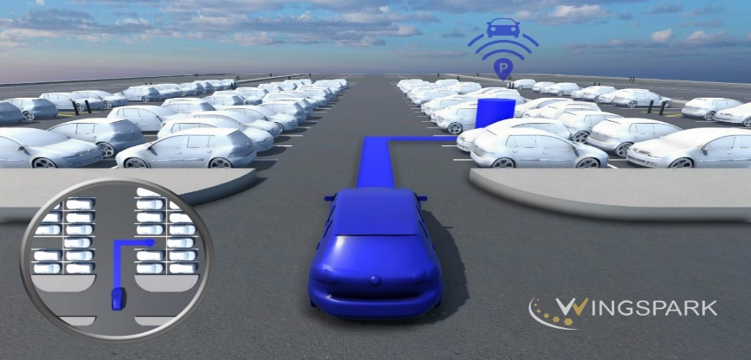
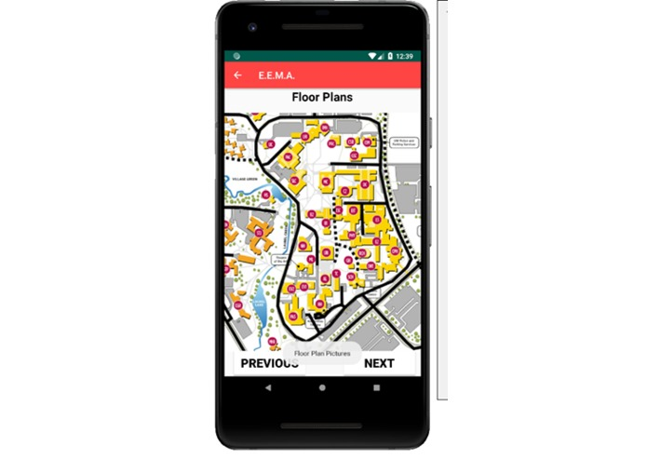
Athens: The mobility-efficient city Use Cases
Smart airport parking management
AR/VR services
Application for evacuation

Slide 14
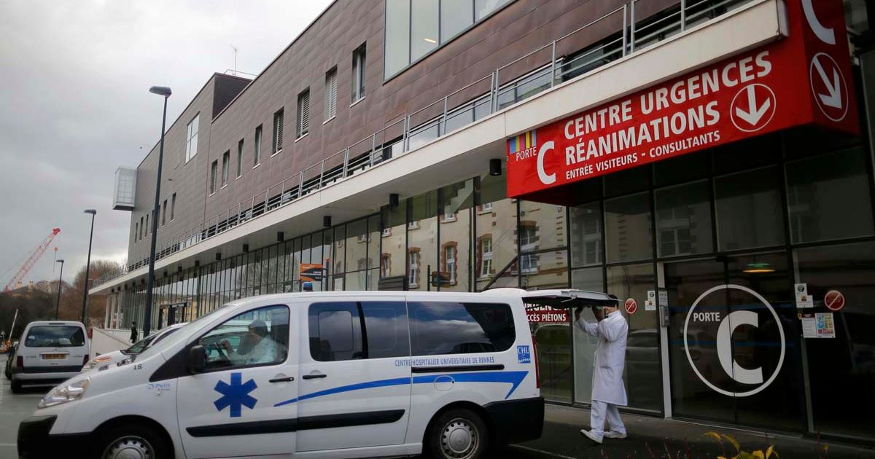
Rennes: The safe city
5G technology greatly improves the safety in the city by providing means to better assist health-related care in all the phases of an incident, ranging from the health monitoring for prevention and early detection, to diagnosis and intervention at the ambulance, and surgery at the wireless operation room in the hospital. Also, 5G enables monitoring and remote assistance to tourists from their home country.

Slide 15
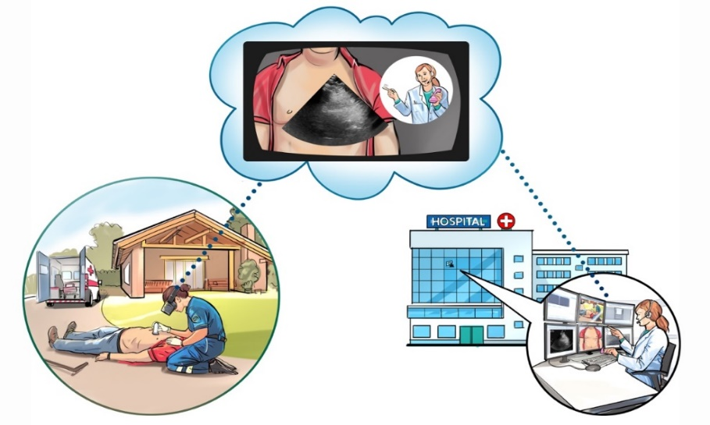
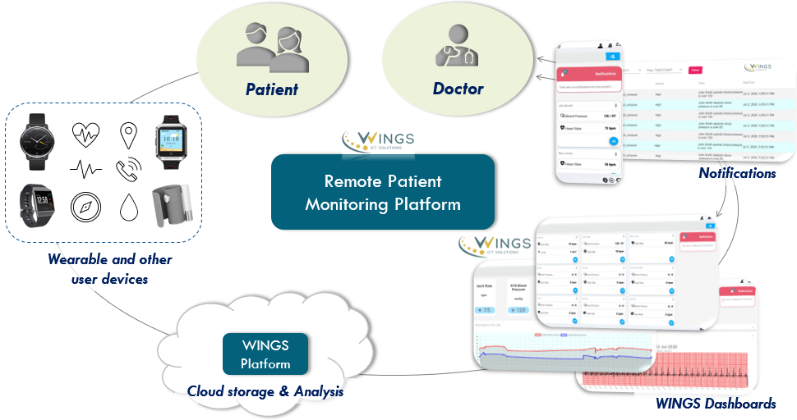
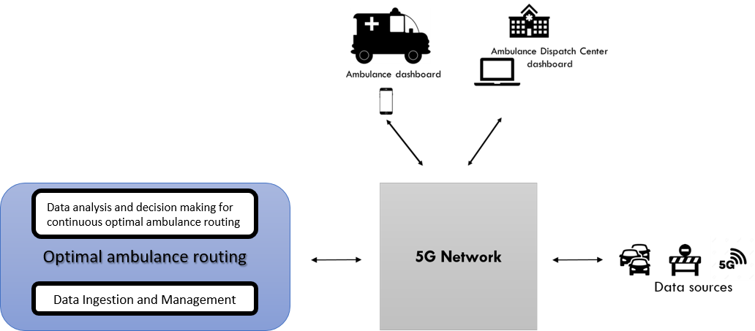
Rennes: The safe city Use Cases
Remote Health Monitoring and Emergency Situation notification
Teleguidance for diagnostics an
intervention support
Optimal ambulance routing

Slide 16
General information regarding QoE and QoS estimation – QoE vs QoS (1)
QoS – Quality of Service:
network characteristics/behavior
performance guarantees given by network provider based on measurements
QoE – Quality of Experience:
- impact of network behavior on end user
- some imperfections may go unnoticed
- some imperfections may render application useless
- not captured by network measurements

Slide 17
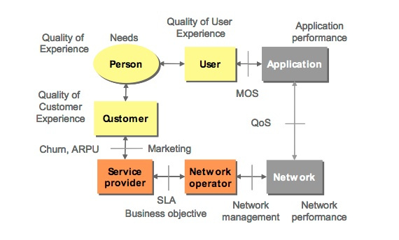
General information regarding QoE and QoS estimation – QoE vs QoS (2)

Slide 18
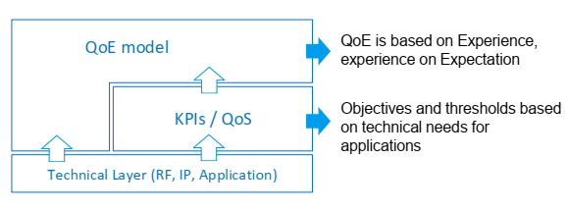
General information regarding QoE and QoS estimation (3)
QoE is not directly depending of radio technology, but the expectation will increase with higher performance. Increasing expectation changes QoE but it happens for all technologies then.
QoE considers a user’s expectation, QoS is more rational based on technical measurements

Slide 19
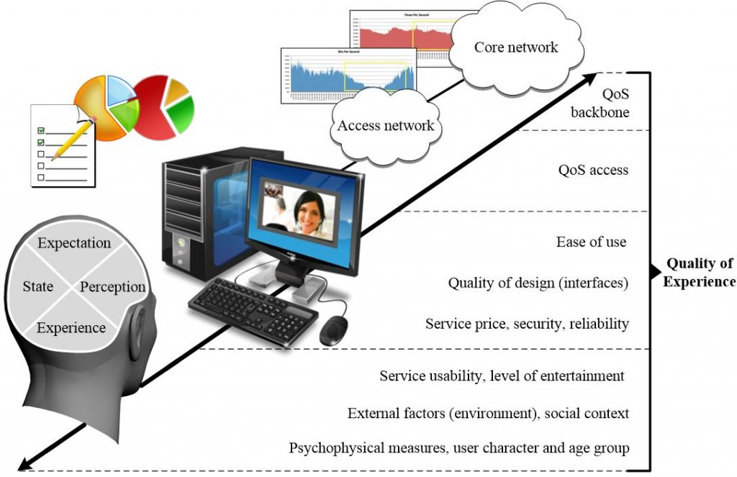
QoE framework
Sourse: QOE4VR: QUALITY OF EXPERIENCE FOR VIRTUAL REALITY APPLICATIONS

Slide 20
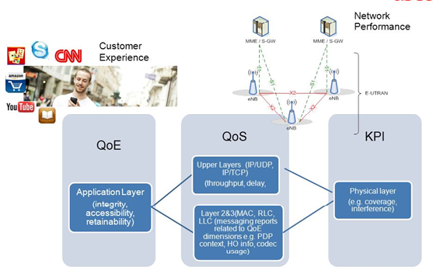
QoE-QoS-KPIs mapping

Slide 21
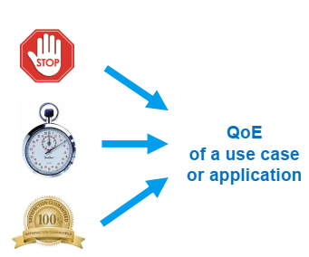
What drives subscriber’s QoE and satisfaction in general?
Accessibility and sustainability ▪ Do I have access to the ‘service’ at all and is it ‘technically’ kept? ▪ (Do I stop waiting because of too long waiting times?) ▪ (Do I stop because of bad quality or limited functionality?)
Waiting time for ‘action’ (task being started and/or completed) ▪ How long the access takes (e.g. Call Setup Time, Video Access Time)
How is the quality / experience during active use ▪ How is ‘quality’ (e.g. video quality) ▪ How is interaction, ‘fluentness’, response time,…

Slide 22
QoE levels
Level of direct perception. In this category all QoE features related to the perceptual information created immediately and spontaneously during the media consumption can be included.
Level of interaction, i.e. the level that includes human-to-human and human-to-machine interaction. Features include responsiveness, naturalness of interaction, communication efficiency, and conversation effectiveness.
Level of the usage situation of the service, i.e. the physical and social situation. Examples of such features are the accessibility and the stability during a usage instance and can be categorized at the situational level.
Level of service, which is related to the usage of the service beyond a particular instance. Aesthetic feeling, usability, usefulness, joy and ease of use, long-term stability are examples of features included in this category.
Source: Qualinet White Paper on Definitions of Quality of Experience

Slide 23
QoE-QoS estimation model (1)
Each service has most valuable KQIs (QoE):
For set of services there are subset of KQIs (QoE):

Slide 24
QoE-QoS estimation model (2)
For each KQI (QoE):
KQI=f(KPIs)
Normal Equation is a follows :
In the above equation, θ : hypothesis parameters that define it the best. X : Input feature value of each instance. Y : Output value of each instance.
Given the hypothesis function:
where, n : the no. of features in the data set.
The coefficient of multiple correlation R, which is the main indicator of the density of the correlation connection of the generalized factor KQI (QoE) with the factors KPIs (QoS):

Slide 25
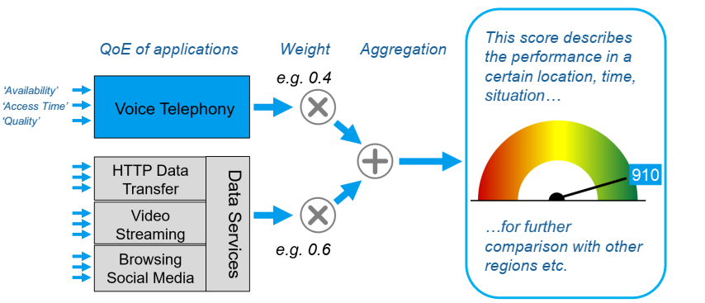
More complex model

Slide 26
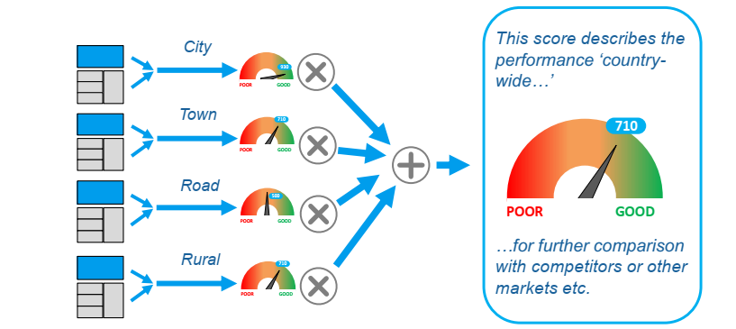
An aggregation model

Slide 27
QoE-QoS estimation model – Architecture
Data collector
KPIs (Delay, Jitter, Bandwidth etc.)
User’s devices
Centralized
Distributed
Machine learning
algorithm s
QoE level report
QoE
analyser
Make
decisions
Planner
Control
Is consumed by
Optimisation techniques
UC-MC-BC transitions
Network
QUIC
Improve
UDP
Multilink
Optimises
ABR

Slide 28
QoE-QoS estimation model – Algorythm
Measurements
Control
Data collector
Establishing dependencies between KQIs (QoE) and KPIs (QoS)
KQI=f(KPIs)
Comparison of estimated KQIs (QoE) with allowable
KQI
KQI
Report
Measured KPIs
KPI
Measured KQIs

Slide 29
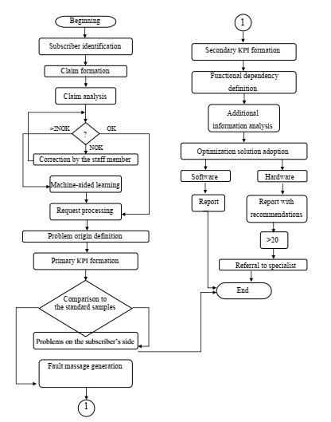
Cellular network condition evaluation method working algorithm

Slide 30
Which model to use?
Use case QoE
Augmented tourism experience
Telepresence
Robot-assisted museum guide
High quality video services distribution
Remote and distributed video production
Remote health monitoring and emergency notification
Teleguidance for diagnosis and intervention support
Wireless operating room
Optimal ambulance routing
Smart airport parking management
Video-enhanced ground based moving vehicles
Emergency airport evacuation
Excursion on an AR/VR-enhanced bus
All KPIs (based on standards, past projects)
Latency
Throughput (DL, UL)
Reliability
Density
Mobility
Coverage
Slice deployment time
Security
Location accuracy
?
Which model?

Slide 31
Methodology – Example on Video Delivery
Development of a QoE versus QoS model
DSCQS (Double Stimulus Continuous Quality Scale) or ACR (Absolute Category Rating)
MOS report
KPI measurements report
KPI measurements
KPIs
QoE vs Qos model
Correlation-regression analysis
QoE=f(QoS)
QoE Estimation
KPI measurements
KPI measurements report
KPIs
QoE estimation report
QoE estimation

Slide 32
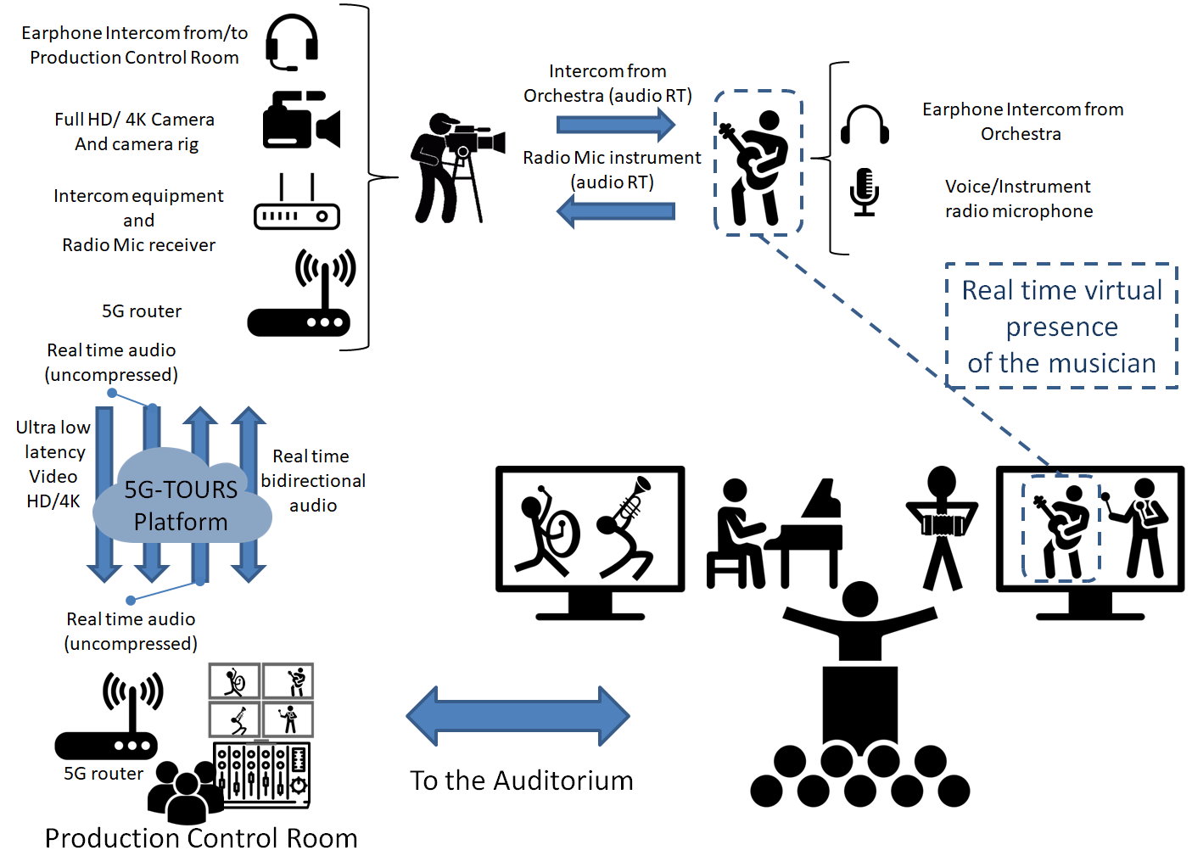
UC5: Remote and distributed video production

Slide 33
The Garden of Forking Paths 5G-TOURS Itinerant orchestra

Slide 34
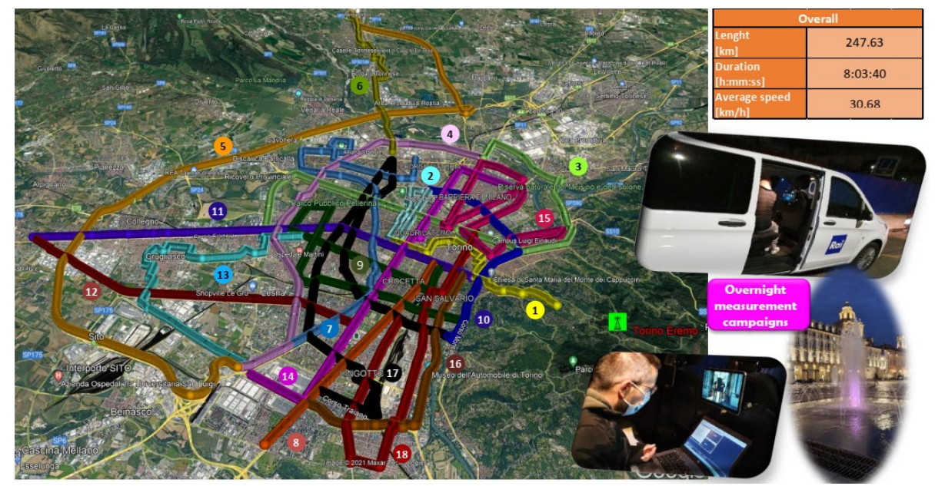
Routes in Turin

Slide 35
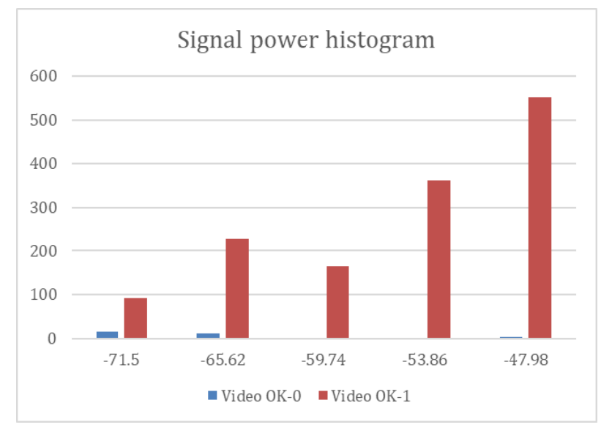
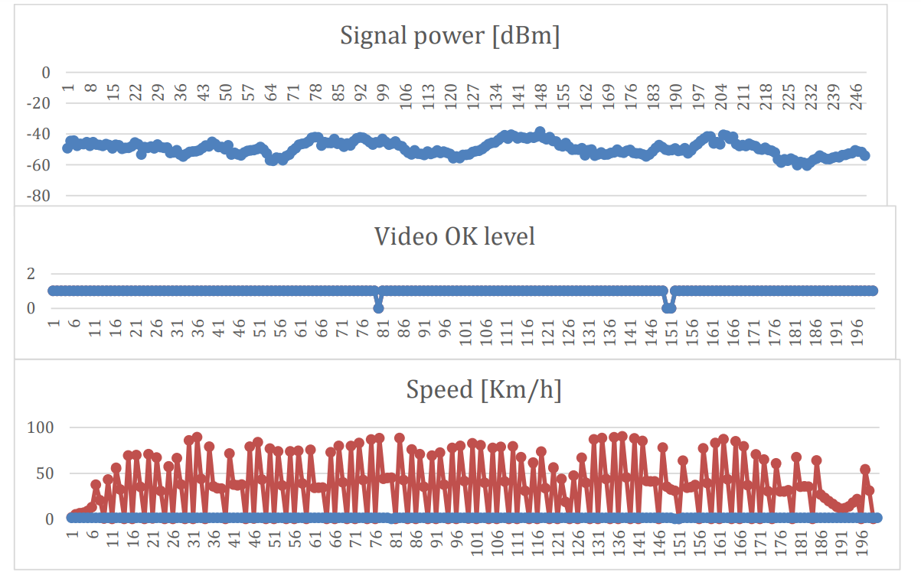
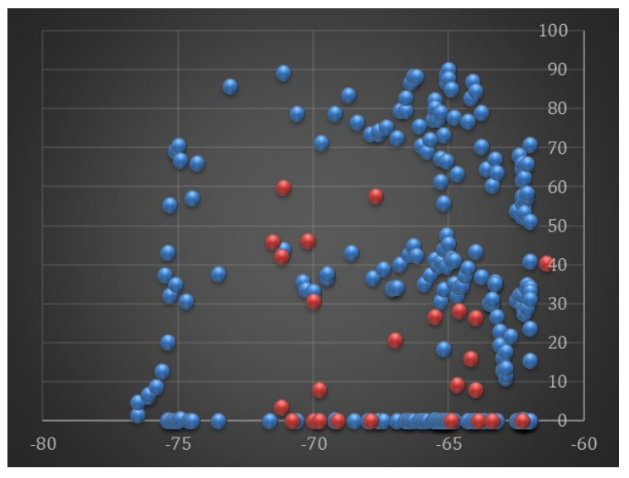
Results of experiments

Slide 36
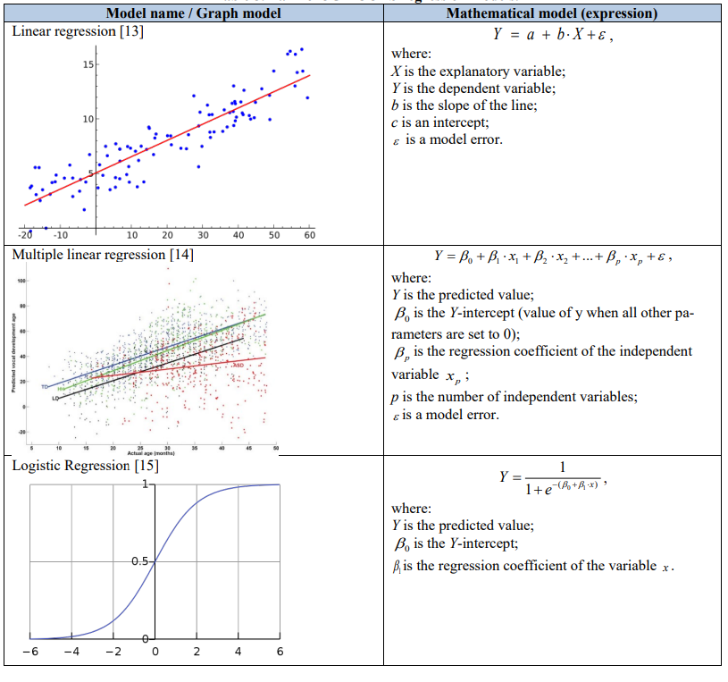
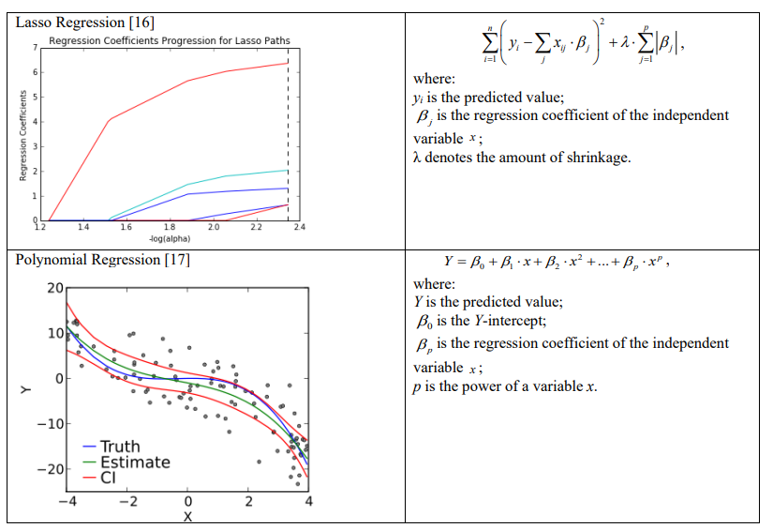
Correlation models

Slide 37
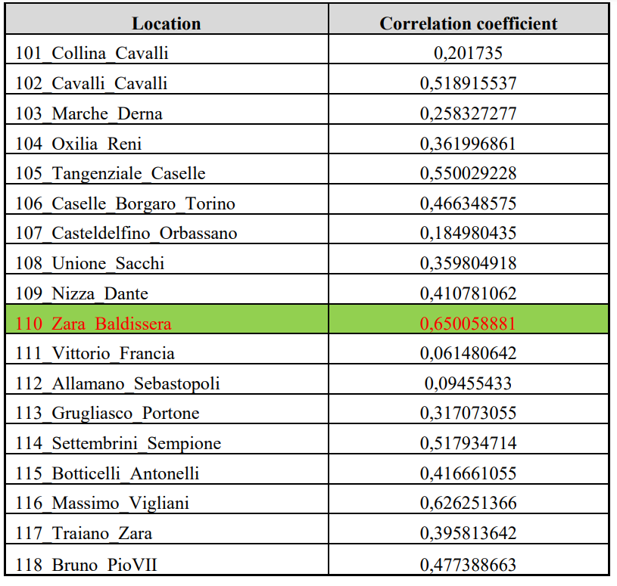
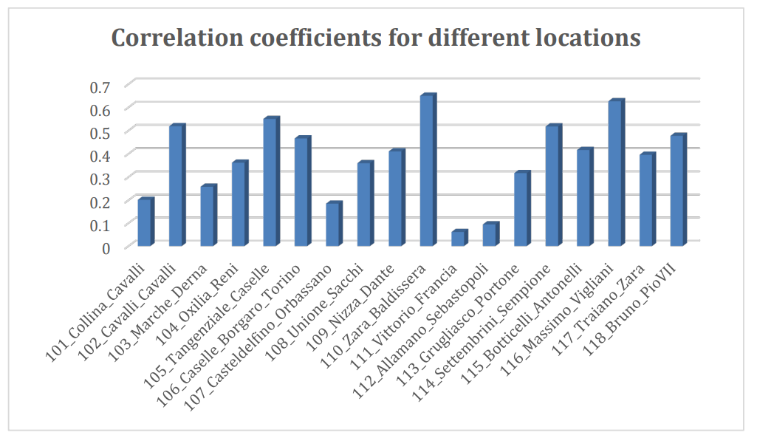
Search for correlational dependencies

Slide 38
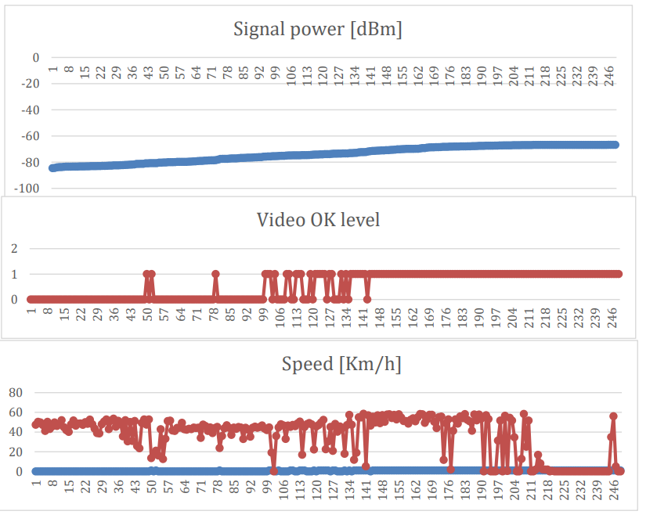
Results of experiments for Zara Baldisera location

Slide 39
Used links
QoE Evaluation: The TRIANGLE Testbed Approach (https://www.hindawi.com/journals/wcmc/2018/6202854/)
QoE Doctor: Diagnosing Mobile App QoE with Automated UI Control and Cross-layer Analysis (https://www.ics.uci.edu/~alfchen/alfred_imc14.pdf)
Concept and Implementation of Video QoE Measurements in a Mobile Broadband Testbed (https://tma.ifip.org/wp-content/uploads/sites/7/2017/06/mnm2017_paper10.pdf)
Quality of Experience for Telemedicine (https://business.esa.int/news/quality-experience-for-telemedicine)
YoMoApp (YouTube-Qualität) (https://play.google.com/store/apps/details?id=de.yomoapp&hl=uk)
Real-Time QoE Monitoring System for Video Streaming Services with Adaptive Media Playout (https://www.hindawi.com/journals/ijdmb/2018/2619438/)
Developing a Quality of Experience (QoE) model for Web Applications (https://onlinelibrary.wiley.com/doi/full/10.1111/isj.12192)

Slide 40
Conclusions and action items
Current systems have the ability to collect all information and process it, but they are still unable to do so in a timely manner, unable to provide a good "management experience" to the end user.
Respective method based on the principles of machine learning has been developed to assess and optimize the state of the network in order to improve the quality of service provision to users by cellular operators using the model of service quality control system. Proposed method is a very effective instrument for request formation from users, network status monitoring, service providing quality control integral marks modelling and their optimization, search of degradation reasons and reporting ranging.

Slide 41
OUR SOCIAL MEDIA
http://5gtours.eu/
https://www.linkedin.com/company/30118784/
https://www.researchgate.net/project/5G-TOURS
https://twitter.com/5gtours
https://www.youtube.com/channel/UCYdXMN027pe_Nkc6Hr92-Mw

Slide 42
THANK FOR YOUR ATTENTION!
ANY QUESTIONS?

