Slide 1
Research projects overview
ROMAN ODARCHENKO, DSc, professor
Chair of Telecommunication and radio engineering systems academic department
National aviation university, Kyiv, Ukraine
Senior researcher, State Research Institute of Cybersecurity Technologies
CEO of the Scientific Cybersecurity Association of Ukraine

Slide 2
My introduction
I’m Roman Odarchenko and I’m a Doctor of Technical Sciences, Professor and works as a chair of Telecommunications and Radio Engineering academic department of National aviation university, Kyiv Ukraine; Senior researcher at The State Research Institute of Cybersecurity Technologies.
I’m also a co-founder and CEO of Scientific Cybersecurity Association of Ukraine.
For the past years I was the scientific supervisor (co-supervisor) of more than 5 international and domestic research projects related to cybersecurity. Also I participated in three research projects under the Horizon 2020 program (5G-Xcast (https://5g-xcast.eu/), 5G-TOURS (http://5gtours.eu/), 5GASP (https://5gasp.eu/)). Currently, I’m investigating different approaches to Cyberwars in real conditions on practical use cases and want to share this knowledge with the audience.

Slide 3
Domestic Ukrainian projects
Methods of building secure mobile government radio communication networks based on 5G networks in Ukraine, state registration number 0120U101401 (2020 – 2021)
Methods of increasing the operational efficiency of telecommunication and radio-electronic systems of objects of critical infrastructure of Ukraine, state registration number 0122U001804 (2022 – 2023)
Quantum-cryptographic methods of ensuring the confidentiality of the critical information infrastructure of the state" (2017 – 2019)

Slide 4
International projects
Scientific project of the National Science Foundation of the Republic of Georgia named after Shota Rustaveli "Development of a platform to ensure cyber security of 5G cellular networks", 2021
Scientific project of the National Science Foundation of the Republic of Georgia named after Shota Rustaveli "AI-based multilayer 5G security assurance methodology for the needs of special groups of subscribers in Georgia", 2023-2025

Slide 5
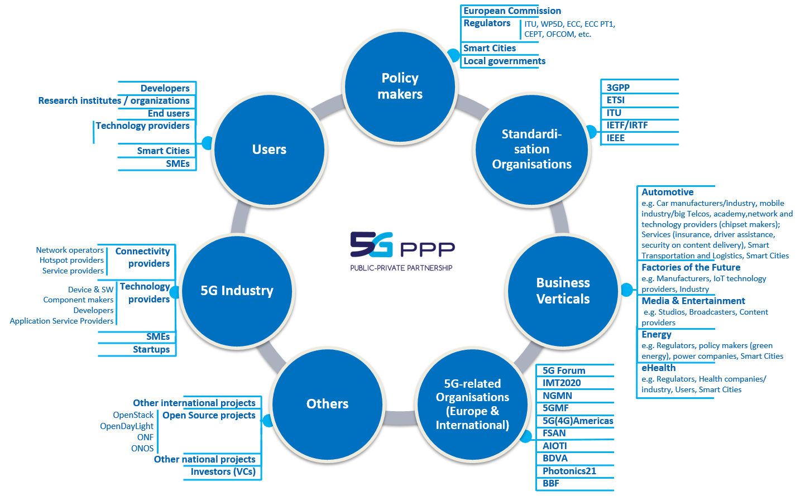
Key 5G PPP stakeholders

Slide 6
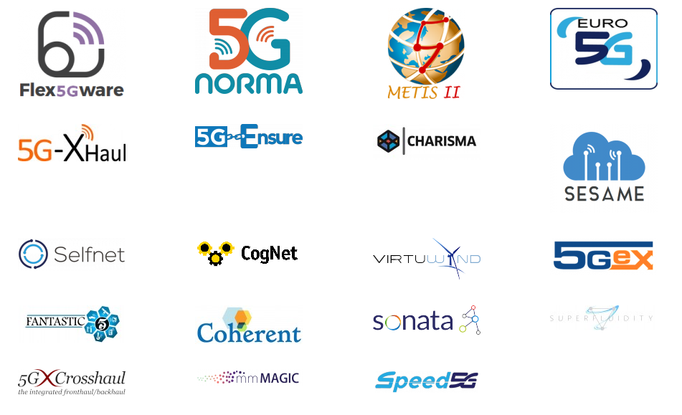
5G PPP PHASE 1 PROJECTS
The 5G PPP was planned to be organised in three or four phases, encompassing research (current stage), optimisation (2016-2017) and large scale trials (2019-2020). It aimed to deploy 5G as from 2020, which will require before 2020 to develop a series of ground-breaking technologies, global standards and to agree on relevant spectrum bands.
https://5g-ppp.eu/wp-content/uploads/2015/10/5GPPP-brochure-final-web.pdf

Slide 7
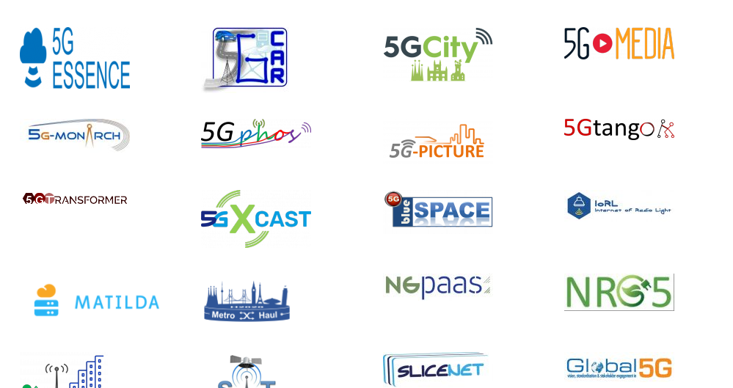
5G PPP PHASE 1I PROJECTS
A key part of the 5G PPP working structure is a set of cross projects and cross initiative working groups. The working groups are the means to establish and publish program level opinions and positions on issues that impact all of the projects and/or may be the basis for liaison or interaction with external bodies such as other Global regions or standards bodies.
https://5g-ppp.eu/wp-content/uploads/2017/11/5GPPP-brochure-phase2-final-web.pdf

Slide 8
5G PPP PHASE III PROJECTS
8 Projects have been retained from the 32 proposals received by the EC in response to the 5G-PPP ICT-19-2019 call.
These eight projects will start in June 2019 and run for about three years to get the European 5G Vision of “5G empowering vertical industries” closer to deployment.
https://5g-ppp.eu/wp-content/uploads/2015/10/5GPPP-brochure-final-web.pdf

Slide 9
Roadmap – my experience
June 2019
July 2019
June 2022
January 2021
December 2023

Slide 10
5G-Xcast description
5G-Xcast devised, assessed and demonstrated a conceptually novel and forward-looking 5G network architecture for large scale immersive media delivery.
Developed broadcast and multicast point to multipoint (PTM) capabilities for 5G considering media, entertainment, automotive, IoT and PWS use cases, and evaluate 5G spectrum allocation options for 5G Broadcast network deployments.
Designed a dynamically adaptable 5G network architecture with layer independent network interfaces to dynamically and seamlessly switch between unicast, multicast and broadcast modes or use them in parallel and exploit built-in caching capabilities.
Experimentally demonstrate the 5G key innovations developed in the project for media & entertainment, and PWS verticals.
http://5g-xcast.eu/

Slide 11
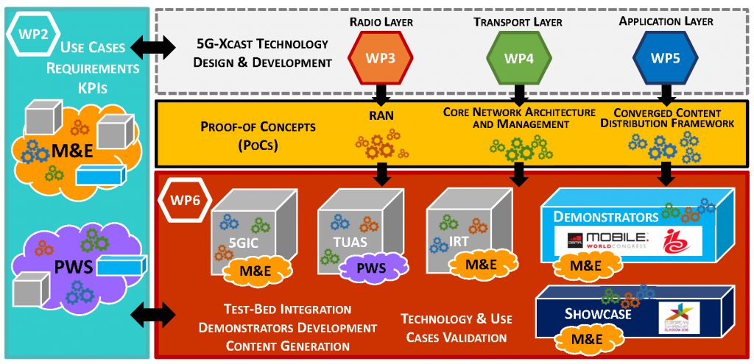
5G-Xcast architecture

Slide 12
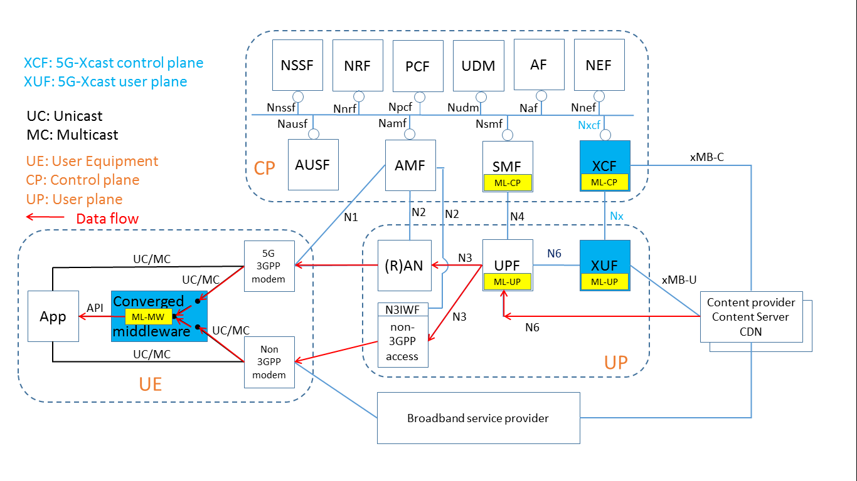
5G-Xcast architecture

Slide 13
5G-TOURS
5G-TOURS vision is to improve the life in the city for the citizens and tourists, making cities more attractive to visit, more efficient in terms of mobility and safer for everybody.
http://5gtours.eu/

Slide 14
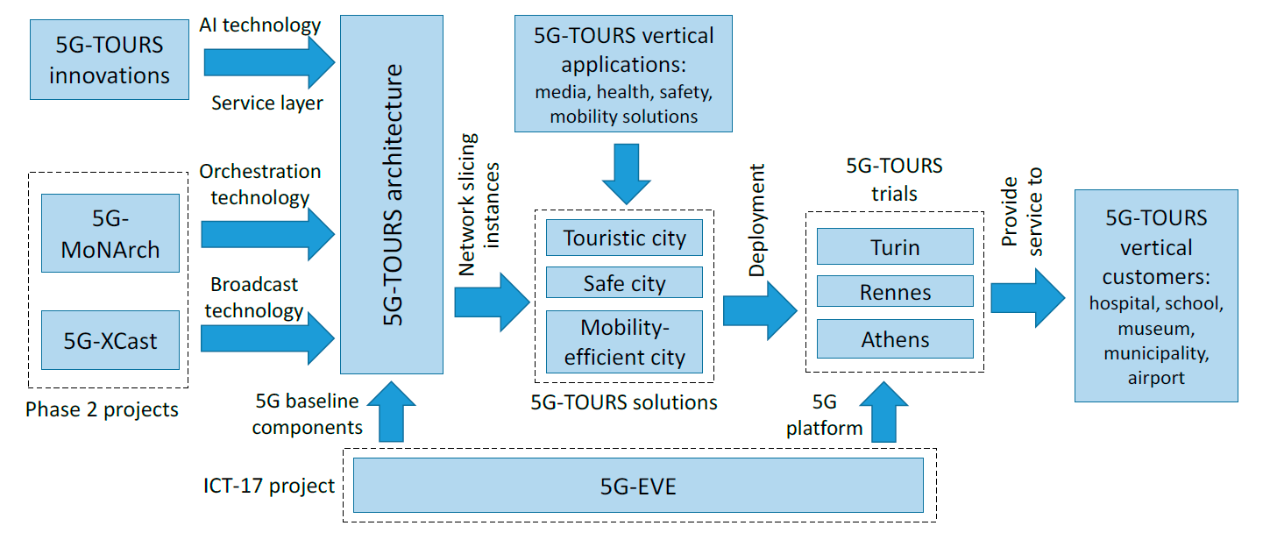
5G-TOURS – links with the other projects

Slide 15
5GASP project
As 5G approaches a very high maturity level, testing and validation of 5G solutions has become of utmost importance. Since verticals have very different needs such as the case of the Automotive industry and Public Protection and Disaster Relief (PPDR), it will require different levels of support into taking their applications and services from concepts, to prototypes and finally to products. However, it is also more and more frequent that services in different verticals need to exchange data, particularly mobility services, such as those found in connected automobiles and PPDR.

Slide 16
Acceleration of the development, testing and certification of NetApps, through the creation of a common platform, DevOps tools and a certification roadmap.
Provide state-of-the-art testbeds where applications for relevant verticals can be tested and validated in a cost-effective way.
Innovate technically by addressing inter-domain use-cases, security and trust aspects associated with NetApp deployment and Operation.
Provide all the community with state-of-the-art tools for test deployment, test automation, continuous integration and monitoring of testbeds, mainly through Open Source Software tools.
Create a practice community, where developers can share knowledge about 5G NetApps
Create a business model around a marketplace of NetApps, by which all stakeholders can share revenue.

Slide 17
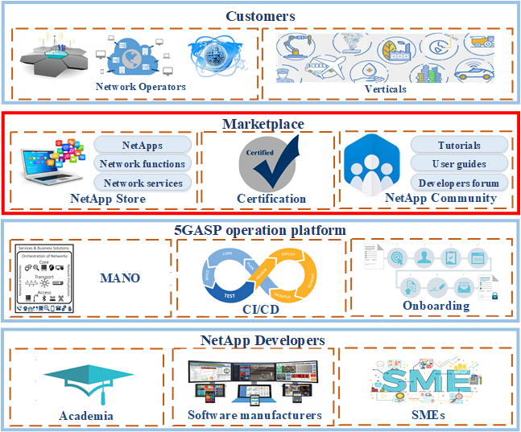
5GASP NetAppStore and NetAppCommunity as innovation enablers

Slide 18
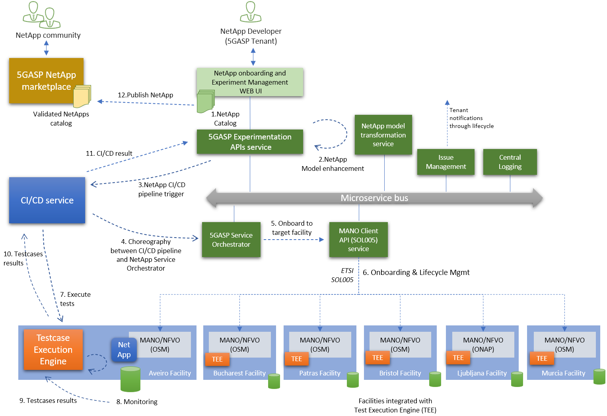
5GASP approach on DevOps experimentation and certification readiness Lifecyle

Slide 19
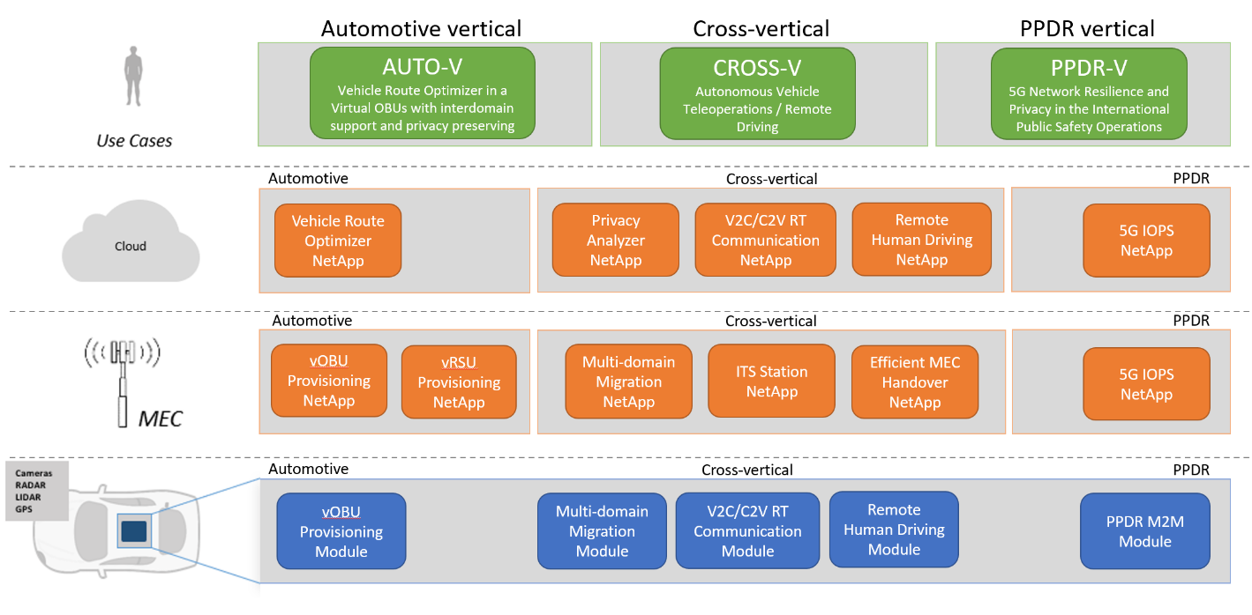
5GASP NetApps and Orchestrated Use Cases

Slide 20
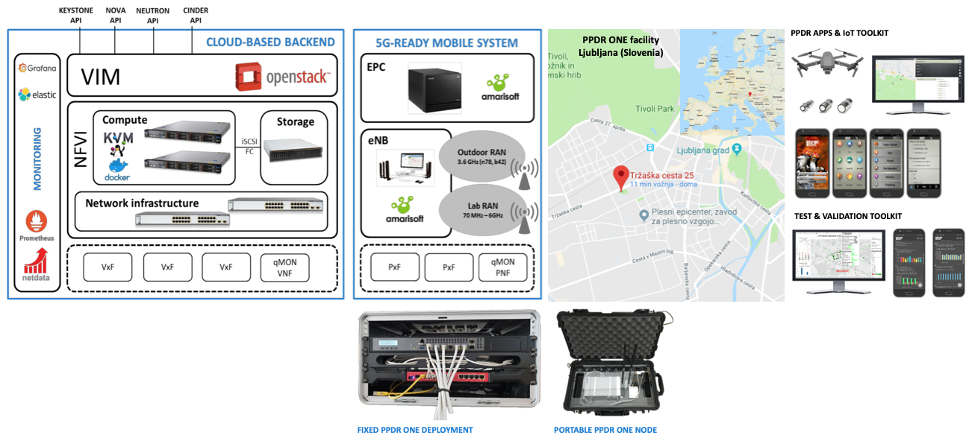
Ljubljana Site

Slide 21
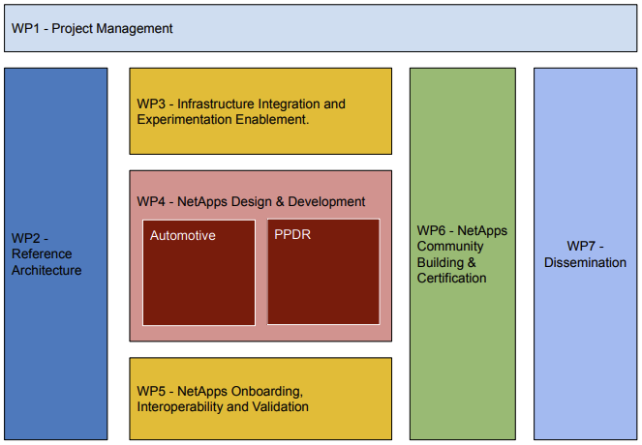
5GASP project structure

Slide 23
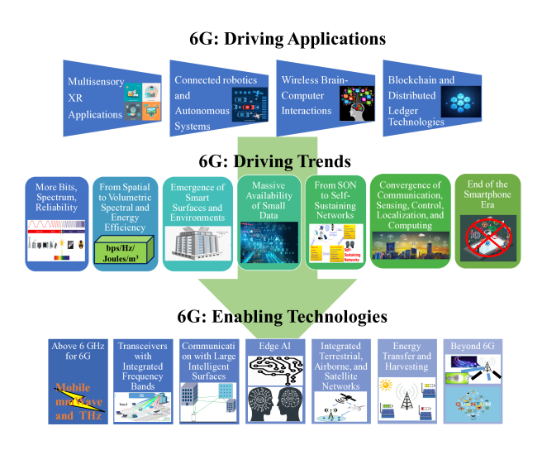
Road towards 6G…

Slide 24
Possible lectures for the next two days
1st day
Machine learning applications for 5G
Correlation models for 5G QoE estimation
2nd day
Machine learning in cybersecurity
Novel Artificial Intelligence tools
Usage of GPT chat in cybersecurity
Main Means And Intermediate Results Of The Russian-Ukrainian Cyber War: Cyber Volunteer Initiatives

Slide 25
CONTACTS
Roman ODARCHENKO
+380936463305
+380507462821
odarchenko.r.s@ukr.net

