Slide 1



Machine learning applications for 5G
ROMAN ODARCHENKO, DSc, professor
Chair of Telecommunication and radio engineering systems academic department
National aviation university, Kyiv, Ukraine
Senior researcher, State Research Institute of Cybersecurity Technologies
CEO of the Scientific Cybersecurity Association of Ukraine

Slide 2


Slide 3
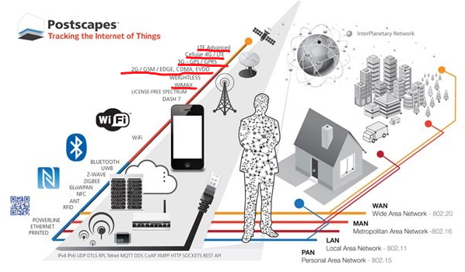
Wireless protocols

Slide 4

Cellular communication -
one of the types of mobile radio communication based on the cellular network. The peculiarity of cellular communication is that the coverage area is divided into "cells", which is determined by the coverage areas of individual base stations. Honeycombs partially overlap and together form a network. On an ideal (flat and unbuilt-up) surface, the coverage area of one base station is a circle, so the network made up of them has the appearance of hexagonal zones (beehives).

Slide 5
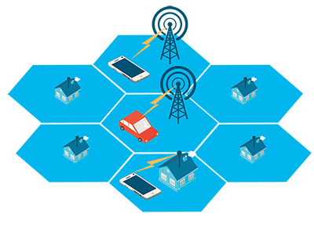
Cellular communication organization scheme

Slide 6
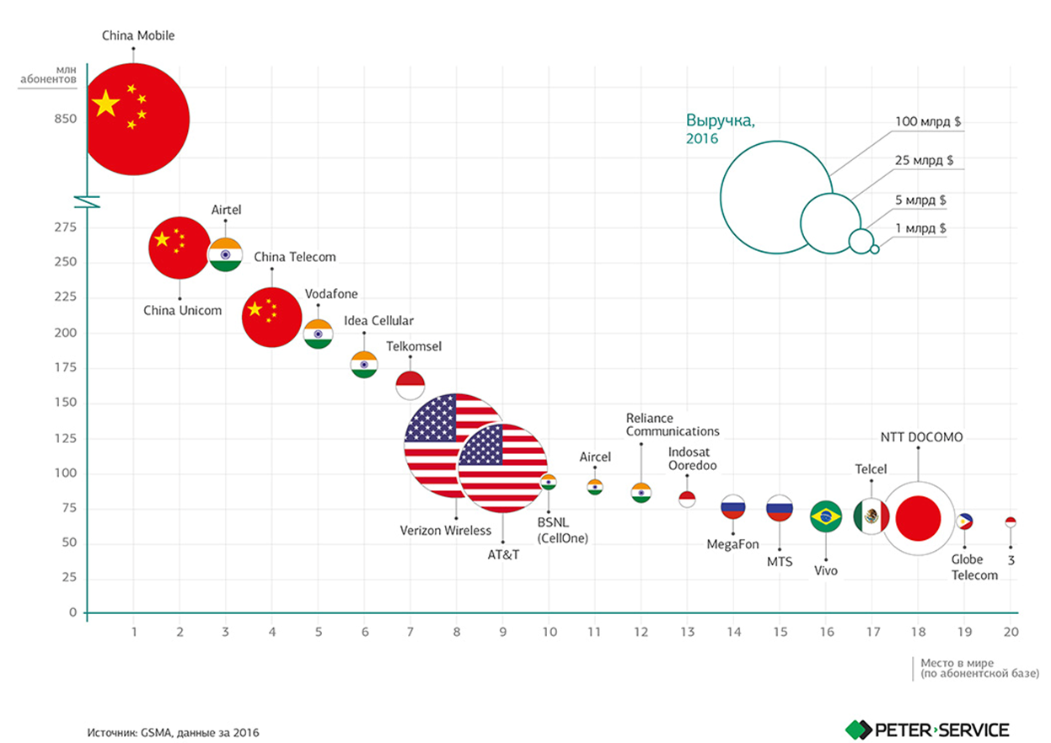

Slide 7

2015 in the world (NTT DoCoMo website)

Slide 8

EVOLUTION OF DEVELOPMENT OF CELLULAR COMMUNICATION NETWORKS

Slide 9
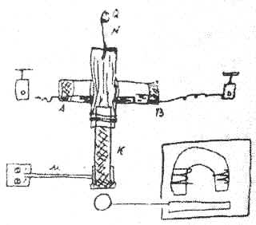
The first radio broadcast
The first receiver A.S. Popov (author's essay)

Slide 10
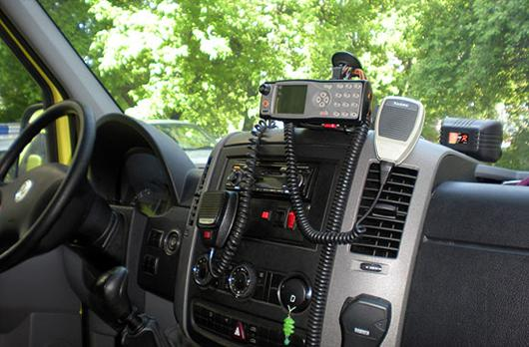
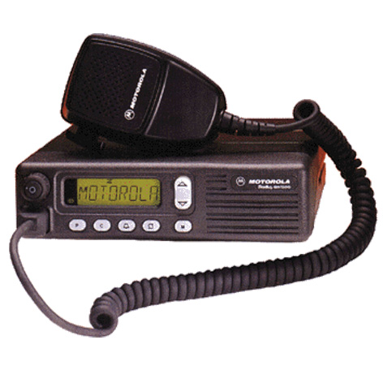
Generation 0 G
PTT MTS IMTS
AMTS OLT MTD

Slide 11
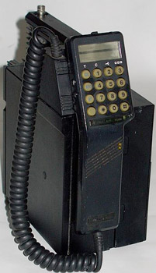

Generation 1 G
NMT AMPS TACS C-450
Radiocom 2000 RTMI

Slide 12
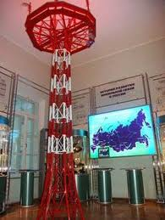
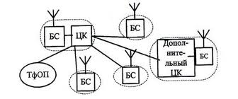
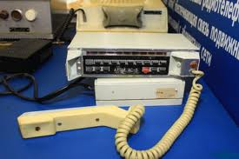
"Altai" system

Slide 13
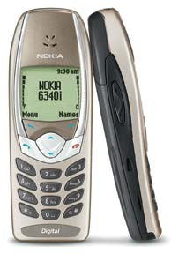
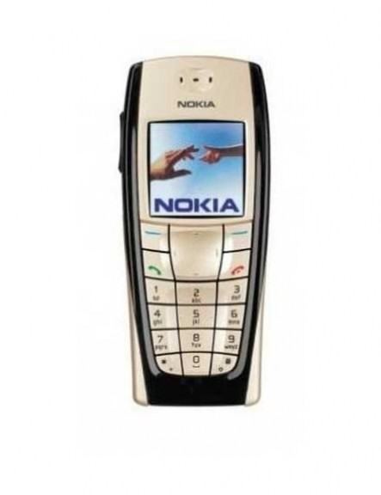
Generation 2 G and 2.5 G
GSM D AMPS CDMA
GPRS EDGE

Slide 14
Possible GSM services:
• Data transmission services (synchronous and asynchronous data exchange, including packet data transmission - GPRS). These services do not guarantee the compatibility of terminal devices and only provide information transfer to and from them.
• Transmission of language information.
•Transmission of short messages (SMS).
• Transmission of fax messages.
• Additional (optional) services:
• Identification of the calling number and limitations of such identification.
• Unconditional and conditional call forwarding to another number.
•Call waiting and holding.
• Conference communication (simultaneous voice communication between three or more mobile stations).
• Prohibition of certain services by the user (international calls, roaming calls, etc.)
•Voicemail.

Slide 15
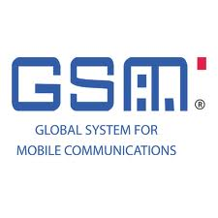
Disadvantages of GSM
• Speech distortion during digital processing and transmission
• Communication at a distance of no more than 120 km from the nearest base station

Slide 16

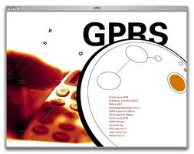
Continuation of GSM
EDGE (2.75 G)
GPRS (2.5 G)

Slide 17
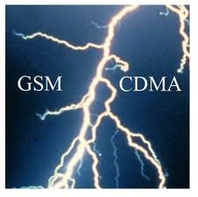
CDMA -
multiple access standard with code division of channels, frequency ranges of 800, 1900 and 2000 MHz;
is used in the USA, South Korea, Hong Kong and has recently been increasingly used in European countries and the world as a whole

Slide 18
Advantages of CDMA:
High spectral efficiency
Flexible allocation of resources
Higher channel security
CDMA phones have lower peak radiated power

Slide 19
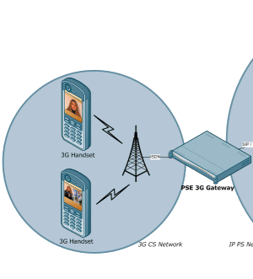
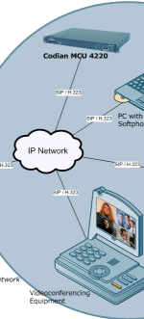
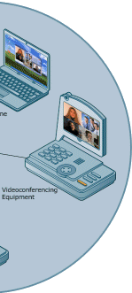
The main requirement for third-generation networks is that they must provide video communication with a minimum resolution of 320x240

Slide 20
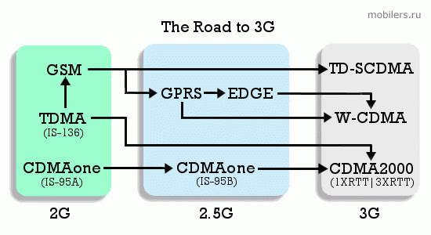
The road to 3G

Slide 21
IMT-Advanced requirements
global compatibility of services and networks;
high quality of mobile communication services;
high economic efficiency of networks;
user-friendly equipment supported by any network in the world;
possibility of worldwide roaming

Slide 22



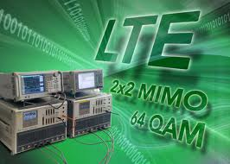
Generation 4 G

Slide 23
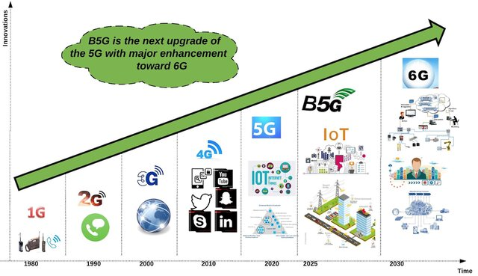
Development of cellular networks

Slide 24
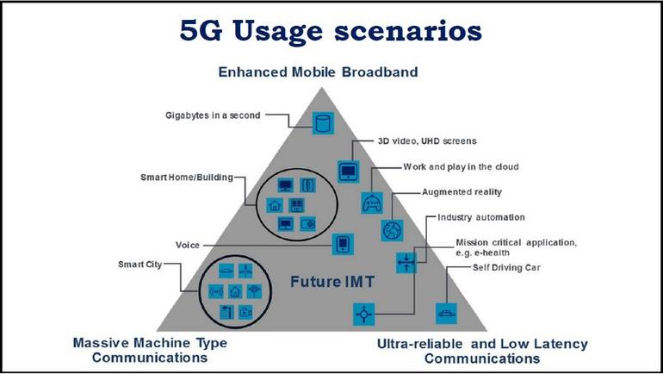
Key types of use

Slide 25
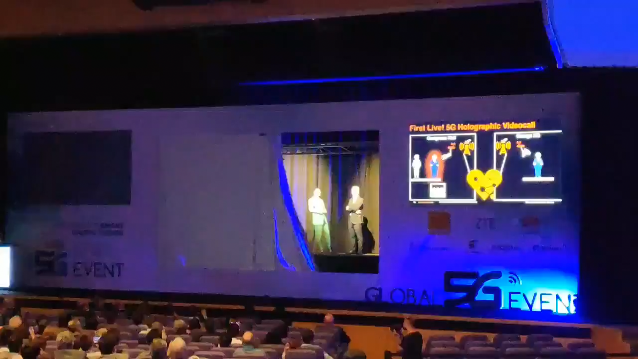

Slide 26
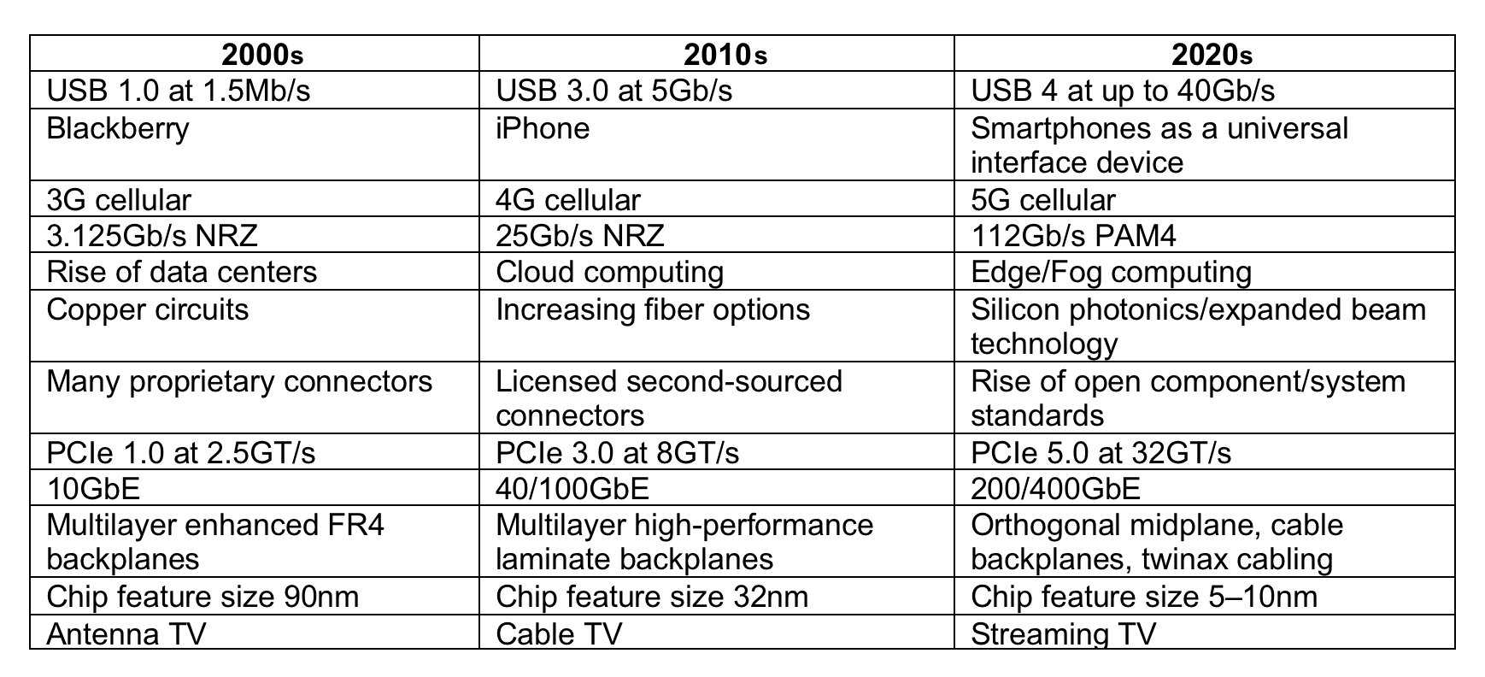
Ways of development of cellular communication networks

Slide 27
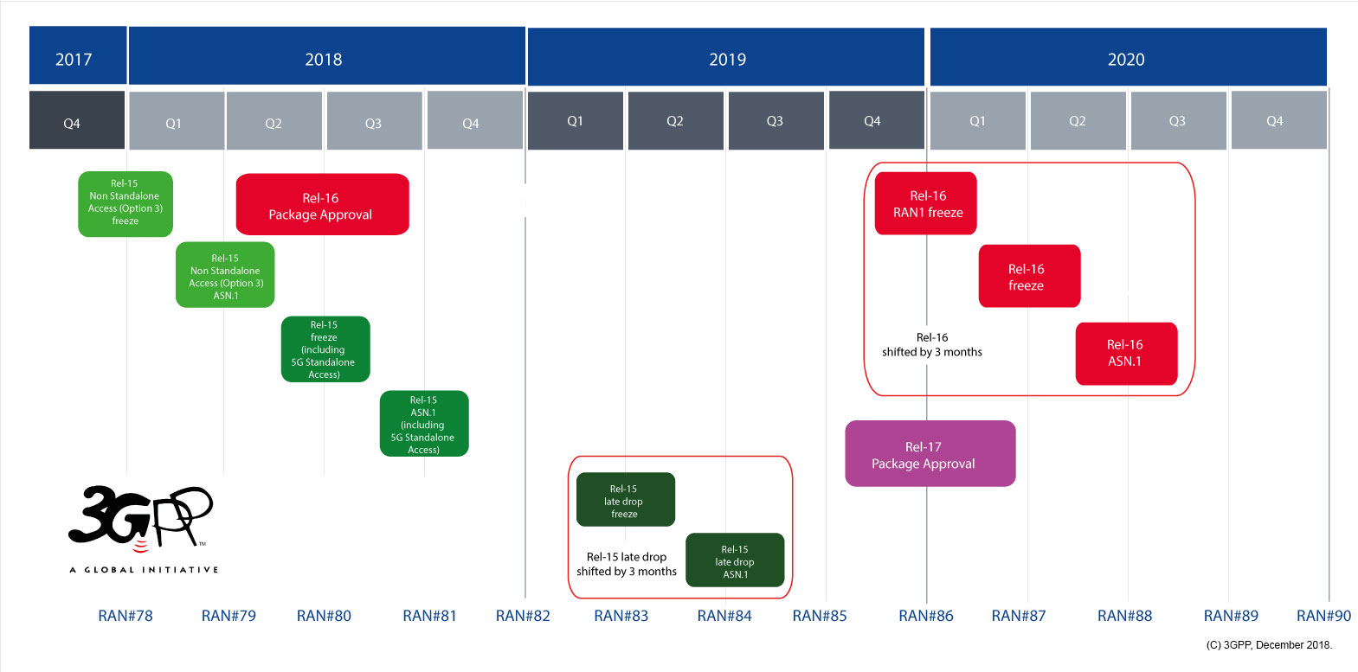
5G standardization

Slide 28
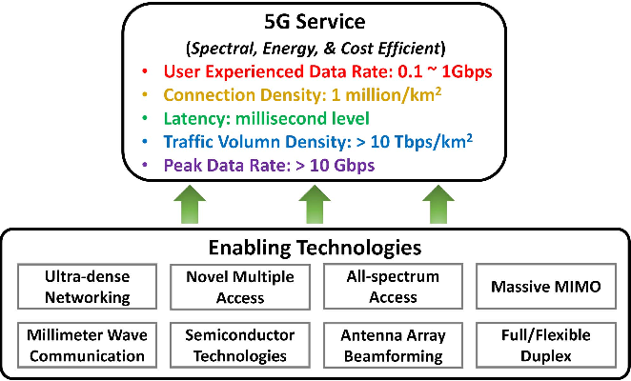
Key technologies of 5G

Slide 29
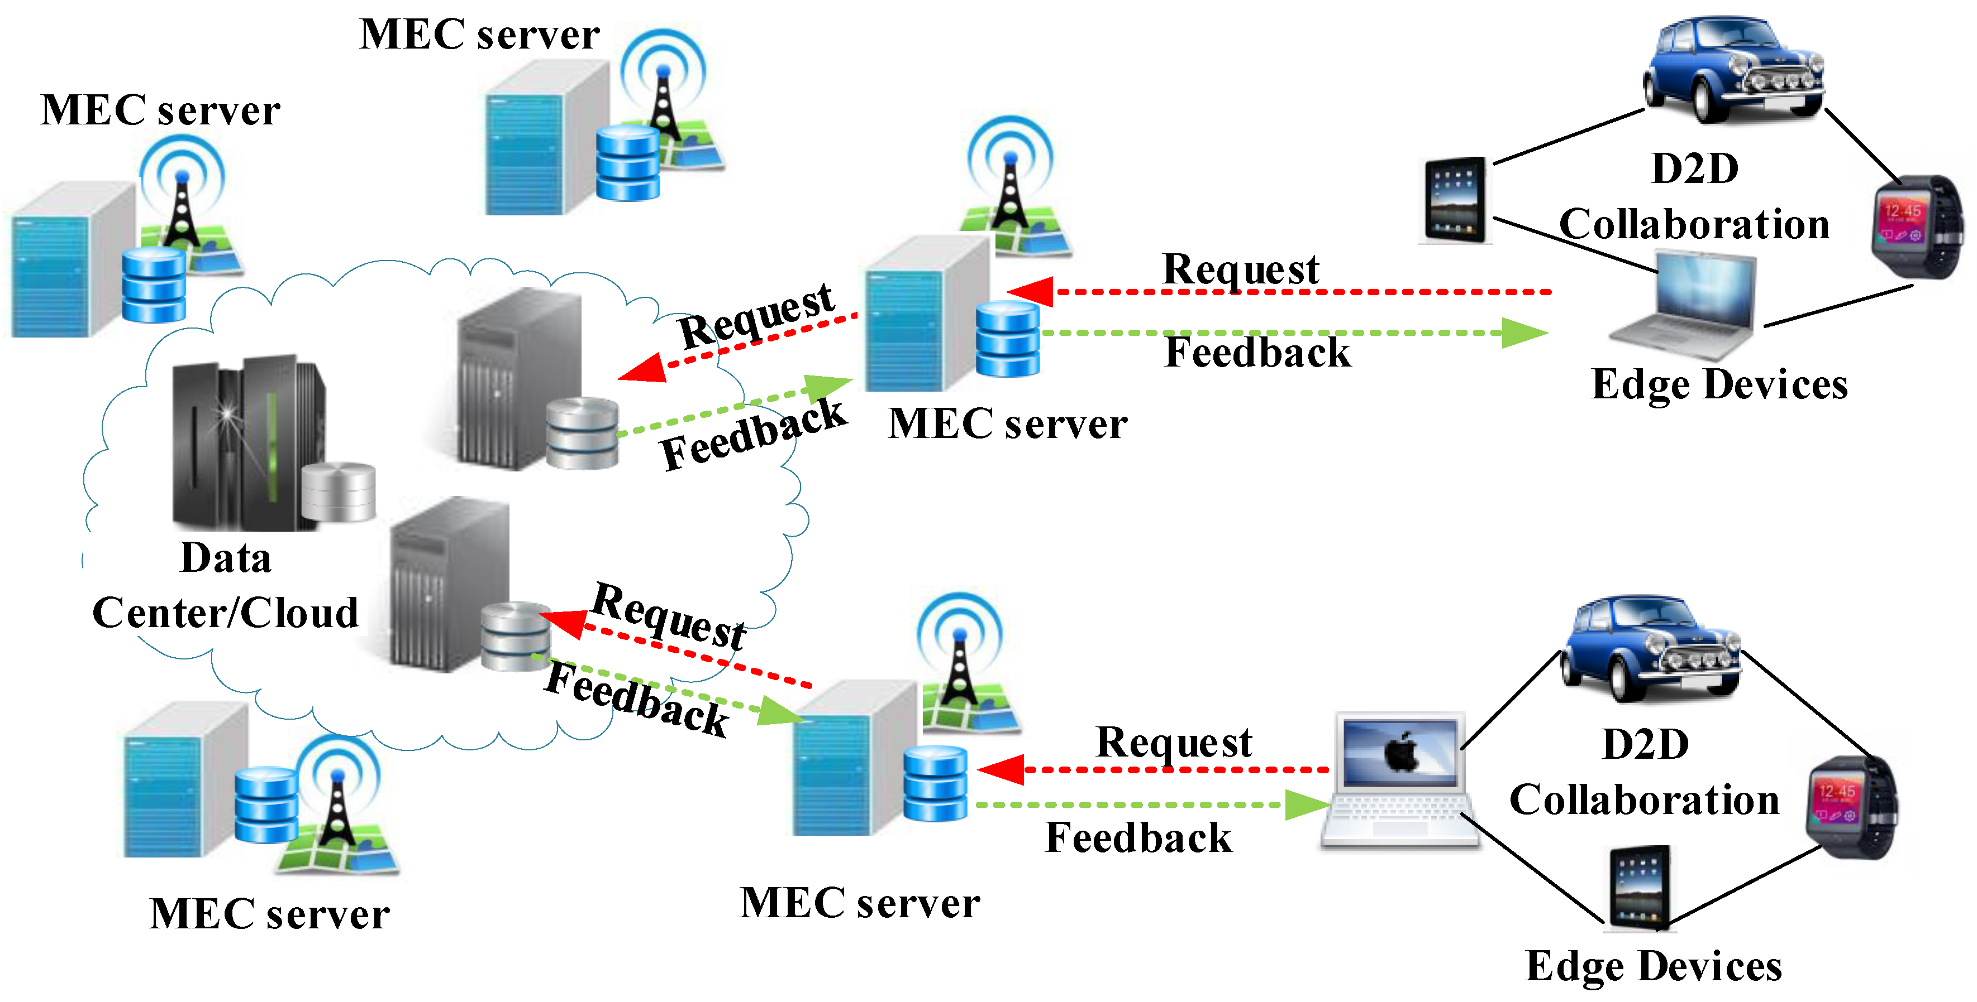
Using the MES architecture

Slide 30
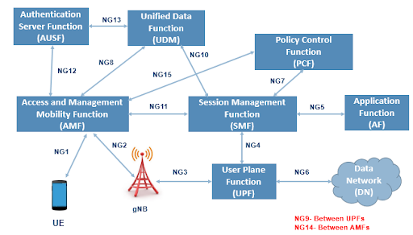
5G network functions

Slide 31
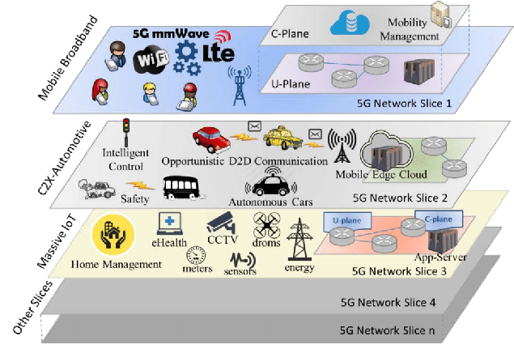
Network slicing

Slide 32
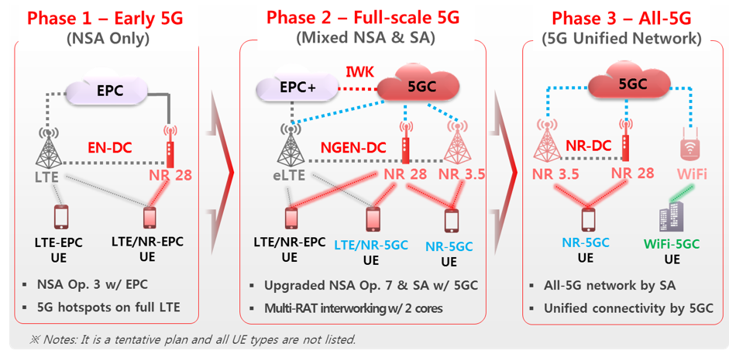
How will 5G be implemented?

Slide 33
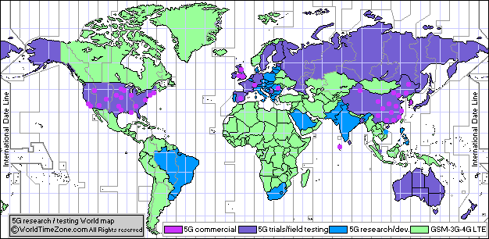
5G commercial network world coverage map
https://www.worldtimezone.com/5g.html

Slide 34

Monaco was the first to provide full 5G coverage
https://korrespondent.net/tech/technews/4116935-monako-pervym-obespechylo-polnoe-pokrytye-5G

Slide 35

Protests against 5G in Switzerland
https://korrespondent.net/world/4142267-v-shveitsaryy-protestovaly-protyv-mobylnoi-sety-5G

Slide 36
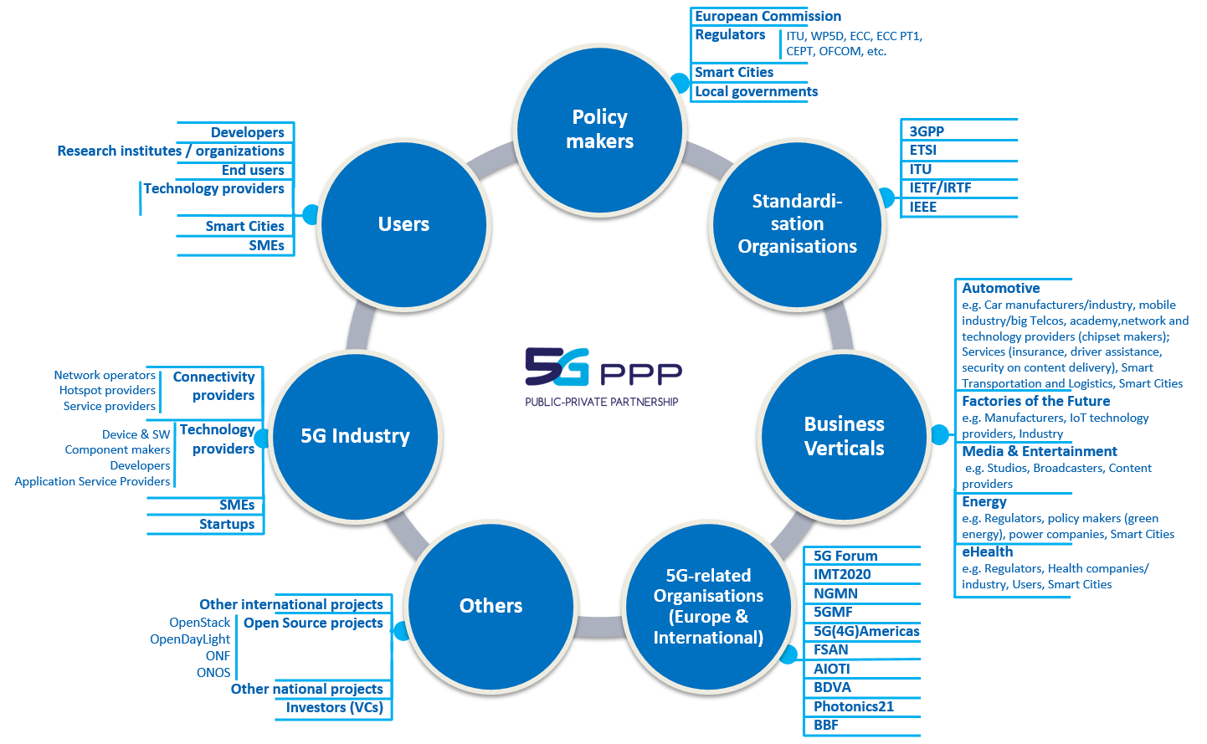
Key stakeholders

Slide 37
Evolution of cellular networks

Slide 38
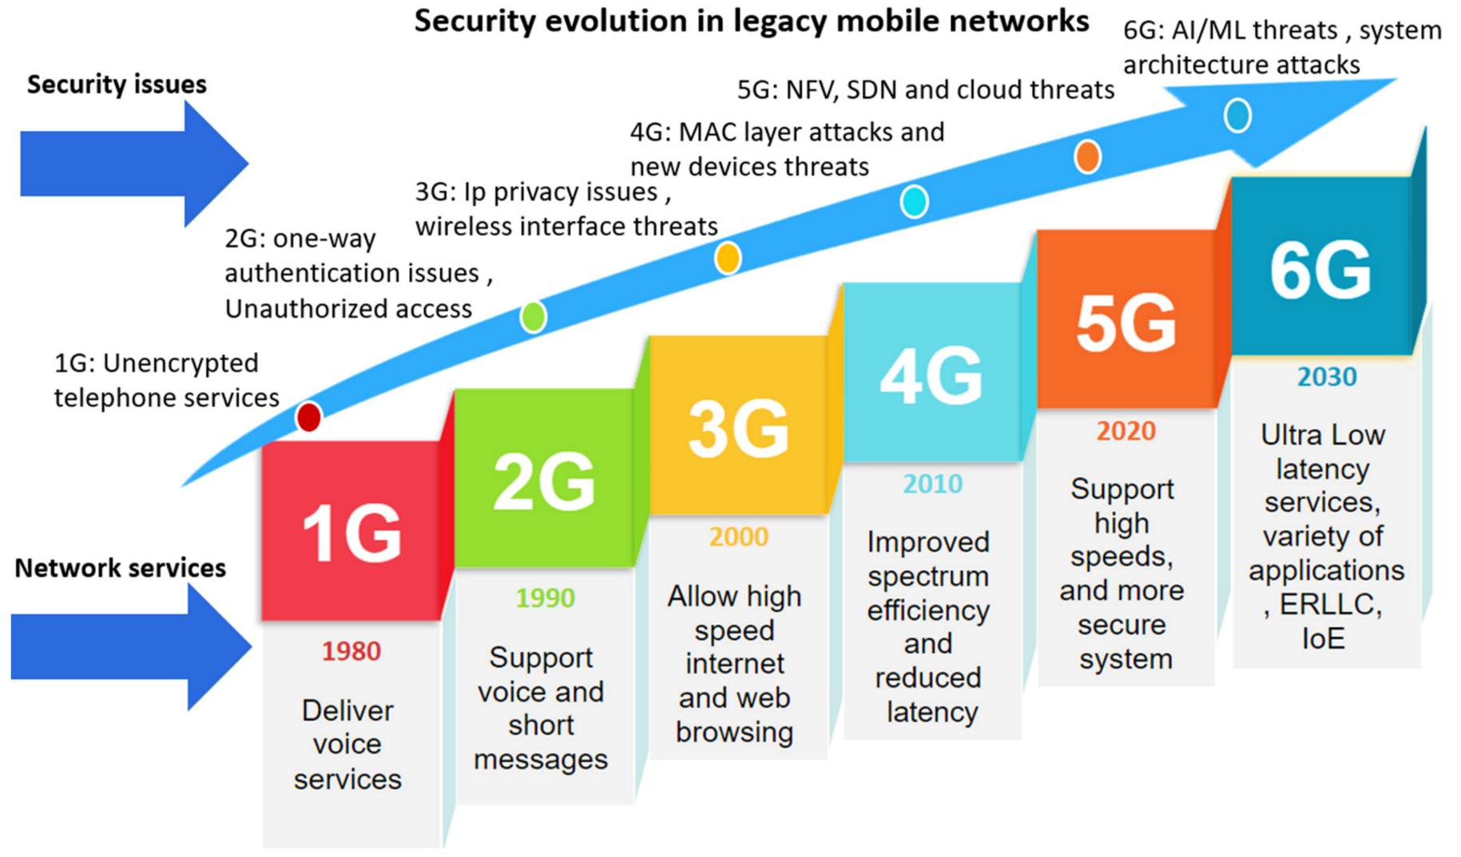
The evolution of cyber security issues
https://www.mdpi.com/1424-8220/22/5/1969

Slide 39
Potential usage of AI for 5G

Slide 40
Some key use cases of AI for 5G (1)
Network Optimization and Self-Healing:
  AI can be used to continuously monitor network performance and make real-time adjustments. It can predict and mitigate network congestion, reroute traffic to reduce latency, and even perform self-healing actions in case of network failures.
Quality of Service (QoS) Management:
  AI can manage QoS by prioritizing critical applications and services, ensuring a consistent and high-quality experience for users, especially in situations with high demand.
Smart Antenna Systems:
  AI can optimize the use of smart antennas to steer the beam towards users, improving signal strength and reducing interference. This is particularly important for millimeter-wave frequencies used in 5G.
Spectrum Management:
  AI can help manage the allocation of radio spectrum efficiently by dynamically adjusting frequencies and power levels based on real-time demand. This is crucial for optimizing spectrum usage, especially in dense urban areas.
Resource Allocation and Load Balancing:
  AI algorithms can dynamically allocate network resources such as bandwidth and spectrum to different users and applications based on their requirements. This helps in efficient load balancing, reducing latency, and ensuring a consistent quality of service.

Slide 41
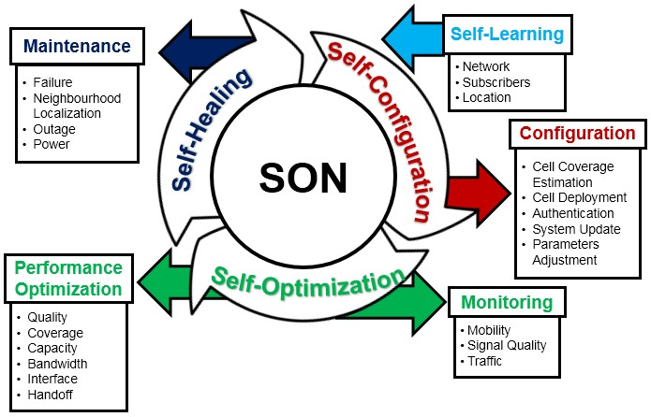
Network Optimization and Self-Healing

Slide 42
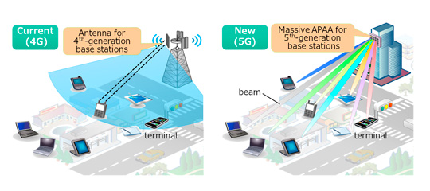
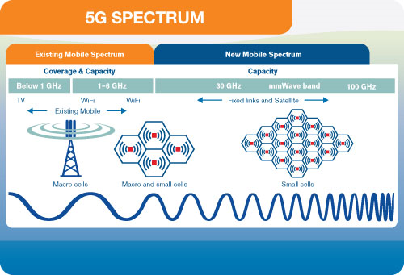
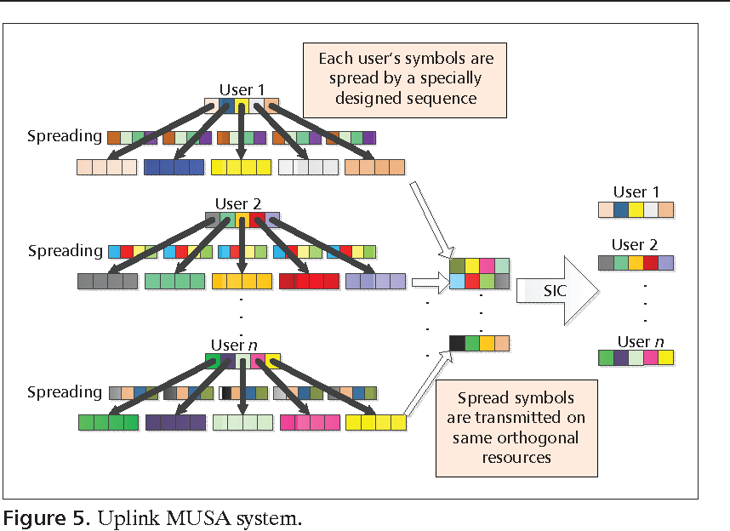
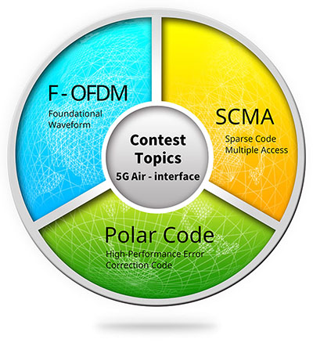
New radio interface

Slide 43
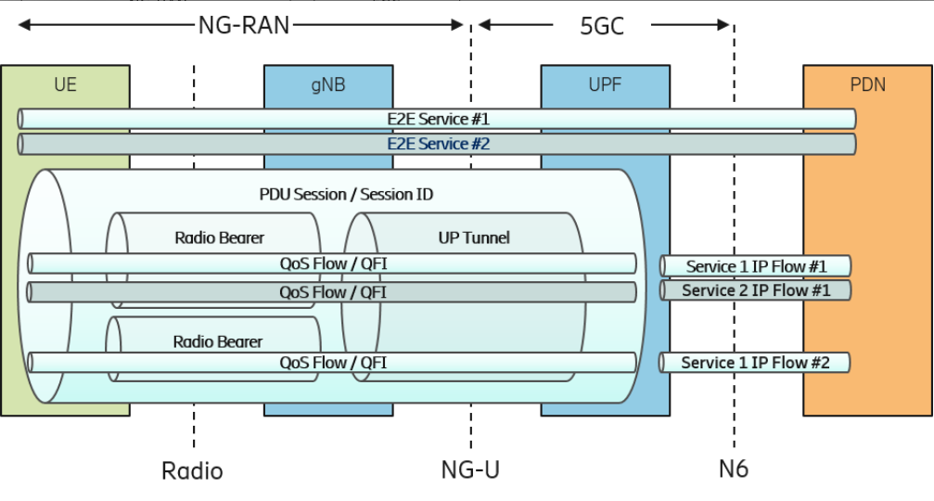
QoS management

Slide 44
Some key use cases of AI for 5G (2)
Security and Threat Detection:
  AI can analyze network traffic patterns to detect anomalies and potential security threats, such as DDoS attacks and intrusion attempts. It can also facilitate the implementation of advanced encryption and authentication mechanisms.
Predictive Maintenance and Fault Detection:
  AI can monitor network infrastructure in real-time and predict potential equipment failures. This proactive approach to maintenance can reduce downtime and improve network reliability.
Network Slicing:
  Network slicing is a key feature of 5G that allows the creation of virtual networks for different use cases. AI can automate the process of managing and optimizing these network slices, ensuring they meet specific requirements for various applications like IoT, AR/VR, or autonomous vehicles.

Slide 45
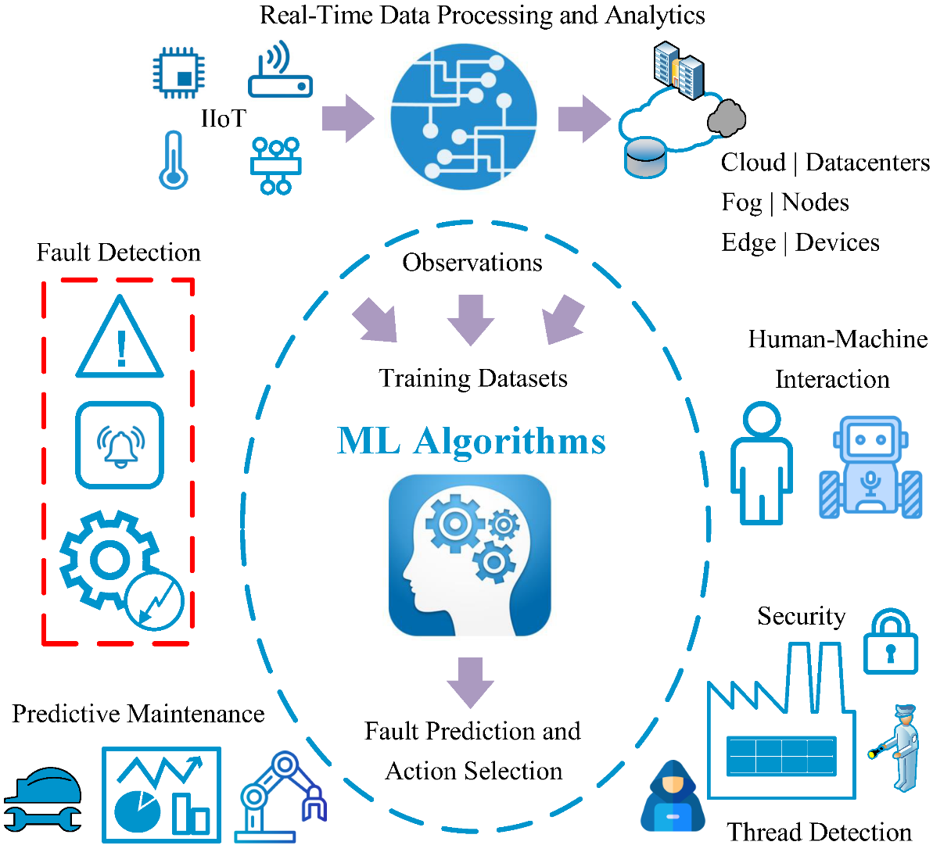
Predictive Maintenance and Fault Detection

Slide 46
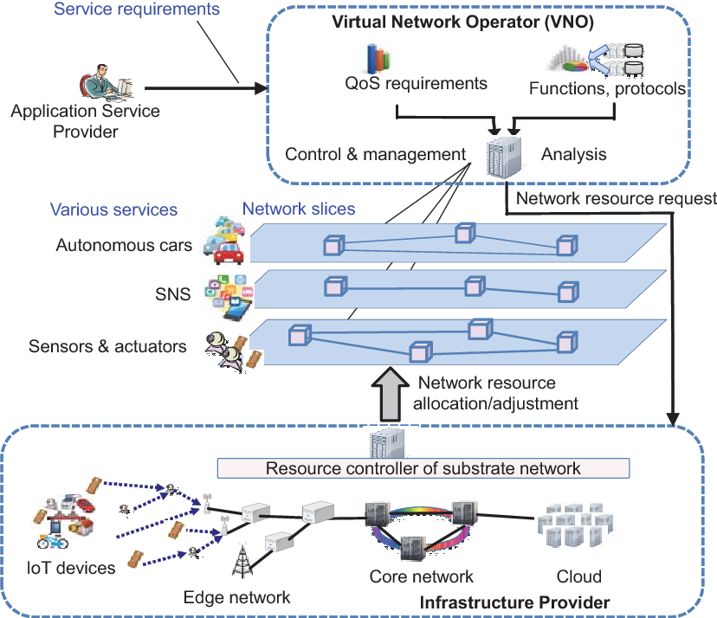
Network Slicing

Slide 47
Some key use cases of AI for 5G (3)
Edge Computing and AI at the Edge:
  AI can be deployed at the network edge to process data locally, reducing latency and offloading the central network. This is essential for applications that require real-time processing, like autonomous vehicles and augmented reality.
User Experience Enhancement:
  AI can personalize the user experience by analyzing user behavior and preferences. It can deliver content and services that are most relevant to individual users, enhancing their overall experience.
Network Planning and Deployment:
  AI can assist in the planning and deployment of 5G networks by analyzing geographical data, user demand, and other factors to optimize the placement of base stations and other network infrastructure.

Slide 48
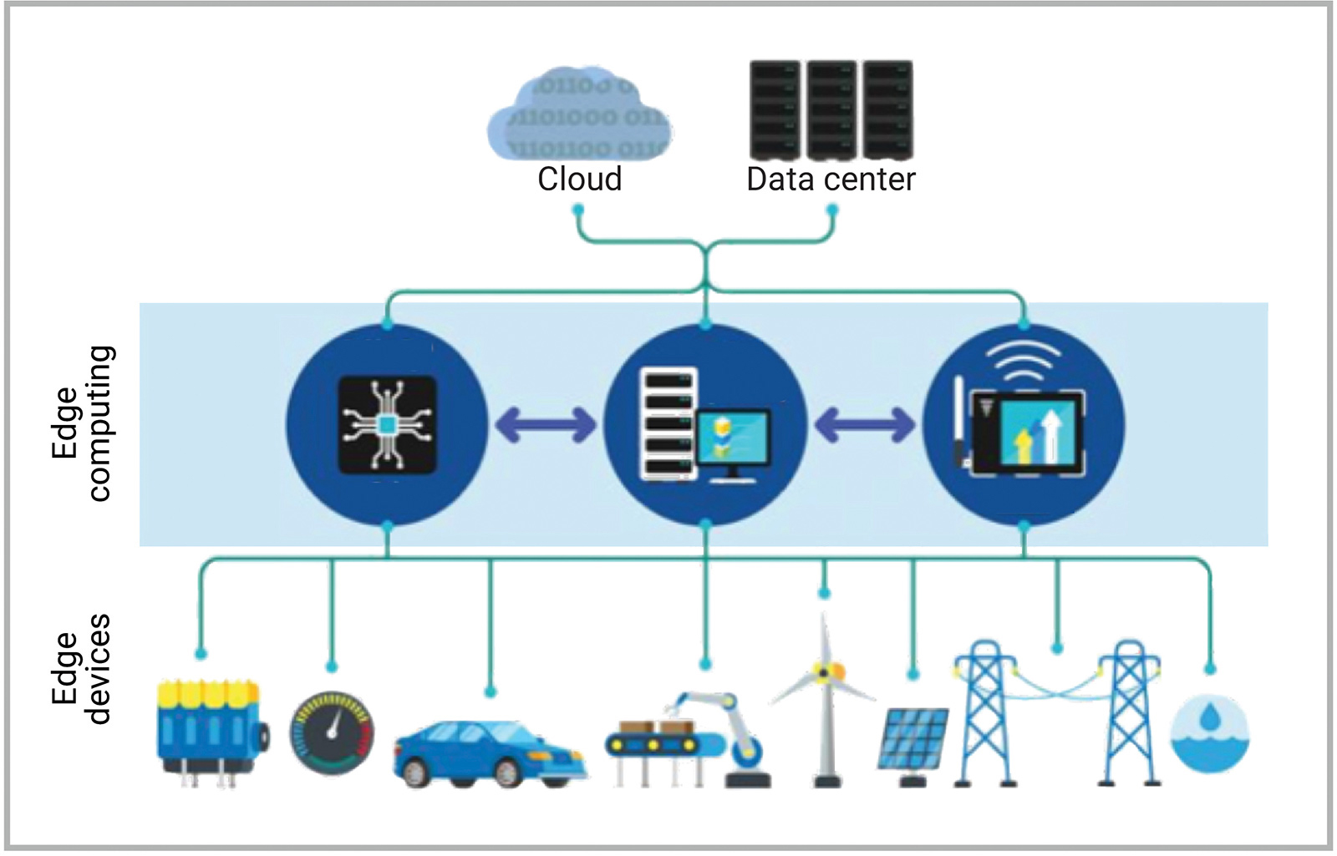
Edge Computing and AI at the Edge

Slide 49
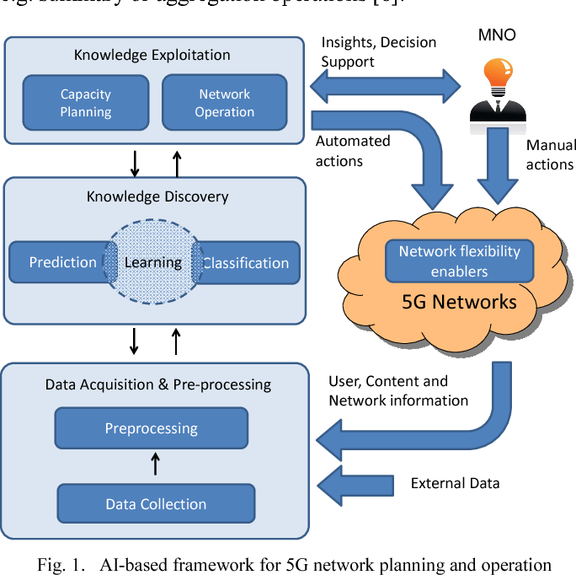
Network Planning and Deployment

Slide 50
Some key use cases of AI for 5G (4)
IoT Enablement:
  AI can handle the massive data generated by IoT devices, making sense of the information and enabling smart applications in various industries, from agriculture to healthcare.
Content Delivery and Caching:
  AI can predict what content users are likely to request and proactively cache or pre-fetch it, reducing the load on the network and improving content delivery speed.

Slide 51
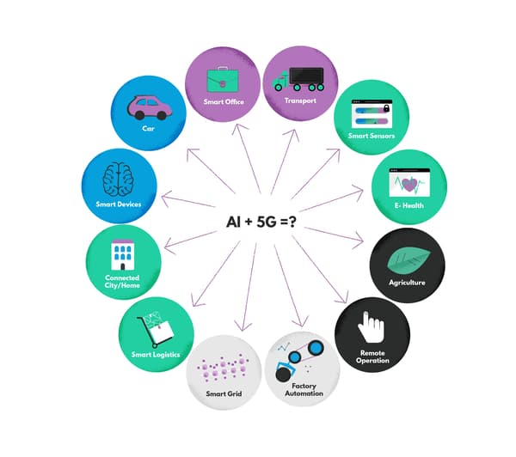
IoT Enablement

Slide 52
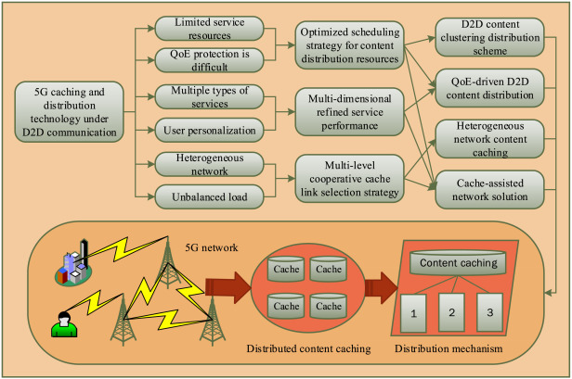
Content Delivery and Caching

Slide 53
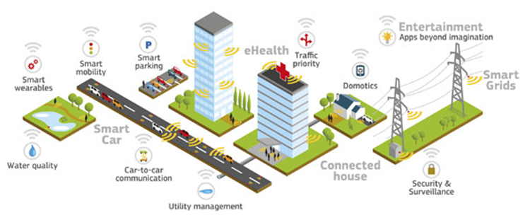


Problem Description (1)
Problem statement:
  4G/5G networks as a part of critical infrastructure
  4G/5G will connect other sectors of critical infrastructure
  new security requirements has to be defined
Negative impact:
  new landscape of cyber threads in 4G/5G
  99% of cyber attacks traverse the network in some way
  5G networks are more vulnerable to cyberattacks than their predecessors

Slide 54
Problem Description (2)
Expected outcomes of a successful solution :
  Satisfying of the network security KPIs (Key Performance Indicator);
  Avoidance of cyber security incidents and potential losses;
  New communication solutions for emergency situations for special users.
Stakeholders of the solution :
  Critical infrastructure facilities in the field of telecommunications and other sectors
  Representatives of relevant state bodies
  Mobile subscribers (including special groups of end-users)

Slide 55
Research summary
Main idea of the solution: New AI-based model of cybersecurity network function implementation to the 4G/5G core architecture.
Goal: provisioning of the highest cybersecurity level in 4G/5G networks.
Key elements : AI-based algorithms, monitoring probes, MEC nodes, 4G/5G core, cloud
Used OpenSource solutions: Open source data sets: NSL-KDD, CIC DATASET "ISCX-SlowDoS-2016“, CIC DATASET "CICDDos2019"
Background: Law of Ukraine on Telecommunications; Decisions of the Government, Orders of the President; Plans of 5G deployment in Ukraine; Law of Ukraine on Critical Infrastructure

Slide 56
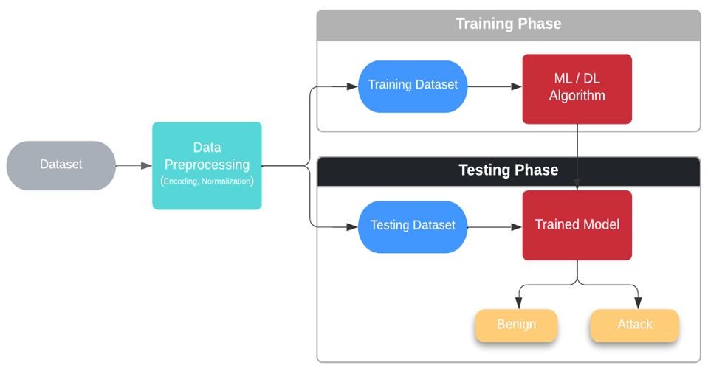
NIDS methodology based on machine learning/deep learning

Slide 57
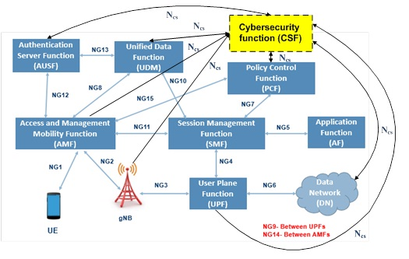

5G core architecture with CSF
Grant number CARYS-19-121

Slide 58
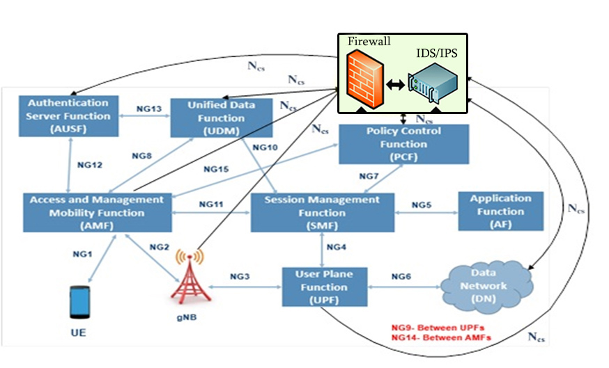
The new scheme
Grant number CARYS-19-121

Slide 59
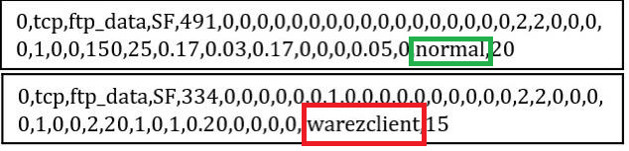
Proposed architectural solution
Edge
server
Edge
server
Edge
server
Artificial Intelligence

Slide 60

Concept of cyber security network function implementation
Grant number CARYS-19-121

Slide 61

The concept of a self-driven cyber security system
Grant number CARYS-19-121

Slide 62
How it works?
Grant number CARYS-19-121

Slide 63

Typical use cases

Slide 64
Implementation of the proposed approach
Data exchange
Mobile Edge
Artificial Intelligence
Artificial Intelligence
Edge solution

Slide 65

Network Intrusion Detection System datasets

Slide 66

AI-based solution testing (1)
FOLLOWED APPROACH
1. Two DOS datasets:
  DOS1: 'LDAP', 'MSSQL', 'NetBIOS', 'Syn', 'UDP', 'UDPLag‘ (380 MB) -.
  DOS2: ‘Portmap’ attack (85 MB, let us refer to it as.
2. NSL-KDD dataset partitioned the into test (training datasets - 90% of the information), and training datasets (10% of the information).
3. The datasets DOS1 and DOS2 were also partitioned into two datasets, each of them: the training datasets contains 80% of the data, and correspondingly the test dataset contains 20% of the data.
Results: This method that was chosen for the data partitioning generated. The accuracy of the model in the case of the NSL-KDD is the best after the training process. We are training the model with each dataset separately at a set is 0.9611049372916336, in the case of DOS1 is 0.9937894736842106 and in the case of DOS2 is 0.9998956703182055.

Slide 67
AI-based solution testing (2)
Attack type | Number of attacks | Identified attacks
BACK | 100 | 84
LAND | 100 | 96
NEPTUNE | 100 | 98
POD | 100 | 100
SMURF | 100 | 91
TEARDROP | 100 | 82
BUFFER_ OVERFLOW | 100 | 76
FTP_WRITE | 100 | 86
LOADMODULE | 100 | 91
ROOTKIT | 100 | 79
GUESS_PASSWD | 100 | 98
MULTIHOP | 100 | 91
SPY | 100 | 83
PROBE | 100 | 98
IPSWEEP | 100 | 92
NMAP | 100 | 95
PORTSWEEP | 100 | 98
SATAN | 100 | 82
LDAP | 100 | 81
MSSQL | 100 | 84
Portmap | 100 | 97
AVERAGE ACCURACY = 90%

Slide 68
New project approach (1)

Slide 69
New project approach (2)

Slide 70

New project approach (3)

Slide 71

AI-based IoT system for determining the patient's health status

Slide 72
AI for 5G demos
OSM AI-agents feature demo
https://www.youtube.com/watch?v=zTT9XnT7Cfg&ab_channel=5G-TOURS
5GTOURS Innovations: Performance diagnosis on real-time network/service monitoring, AI enhanced MANO
https://www.youtube.com/watch?v=dQBtkeP9rXo&ab_channel=5G-TOURS

Slide 73
Additional proposal for students

Slide 74


5G network deployment options based on Open Source solutions

Slide 75



Planned 5G network at National aviation university

Slide 76


Active 4G network at National aviation university

Slide 77




Results of 4G testing at National aviation university

Slide 78


Slide 79

CONTACTS
Roman ODARCHENKO
+380936463305
+380507462821
odarchenko.r.s@ukr.net

