Slide 1
A Real-Time Intrusion Detection System for Software Defined 5G Networks
Associate Professor Dr. Razvan Bocu
Department of Mathematics and Computer Science
Transilvania University of Brasov, Romania

Slide 2
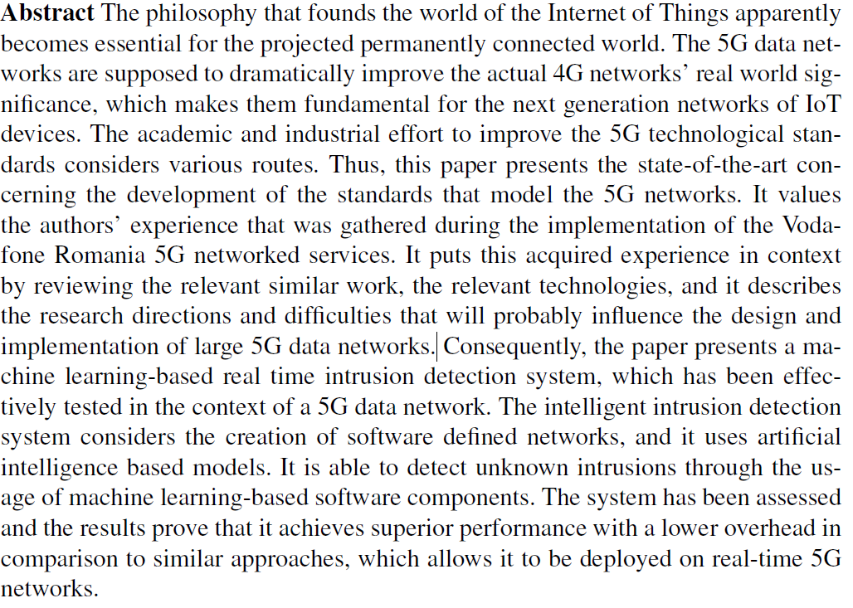
Abstract

Slide 3
Agenda
Technical Requirements
Relevant Technologies
Presentation of the Intrusion Detection System
Performance Assessment

Slide 4
Technical Requirements
High throughput data channels – the deployment of the smart applications requires data links that offer transfer speeds of, at least, 25 Mbps, which are intended to support the high definition data containers, the virtual reality (VR) or augmented reality (AR) applications
Networks that are scalable and structurally flexible – this is determined by the consideration of the mechanism of network functions virtualization (NFV) in order to build the required fronthaul data networks
Very low latency – the 5G IoT networks are intended to support smart applications that should send and receive real-time data, which require communication channels with latencies that are no greater than 5 milliseconds

Slide 5
Technical Requirements
Reliability and resilience – the existence of sensibly more small network cells in a 5G data network involves that the handover should be conducted in an efficient way, while the network coverage is kept at the optimal levels
Data privacy and security – the deployment of applications that process highly senstive data, such as personal health data, implies that the proper mechanisms should be designed and implemented in order to prevent any illegitimate access attempt
Long battery lifetime – the mobility is a central concept in the realm of 5G data networks, and consequently the energy efficiency should be considered

Slide 6
Technical Requirements
Connection density – the 5G data networks are expected to offer concurrent reliable access for a large number of devices, which implies that proper design and implementation decisions are made
Mobility – this technical requirement complements the necessity to offer proper conditions for the deployment of many devices, which require reliable mobile intercommunication data links

Slide 7
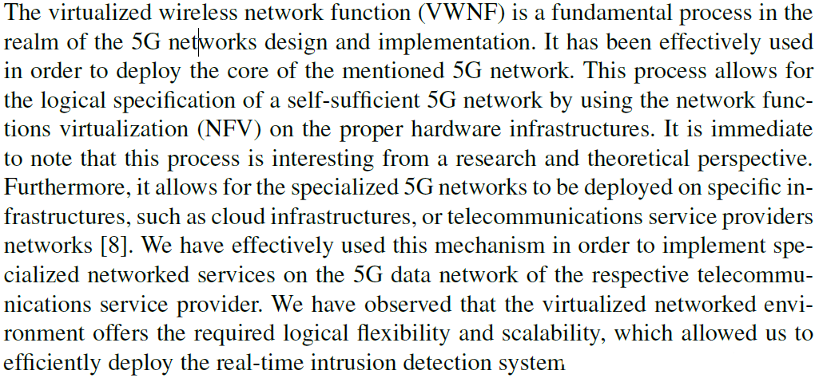
Relevant TEchnologies

Slide 8
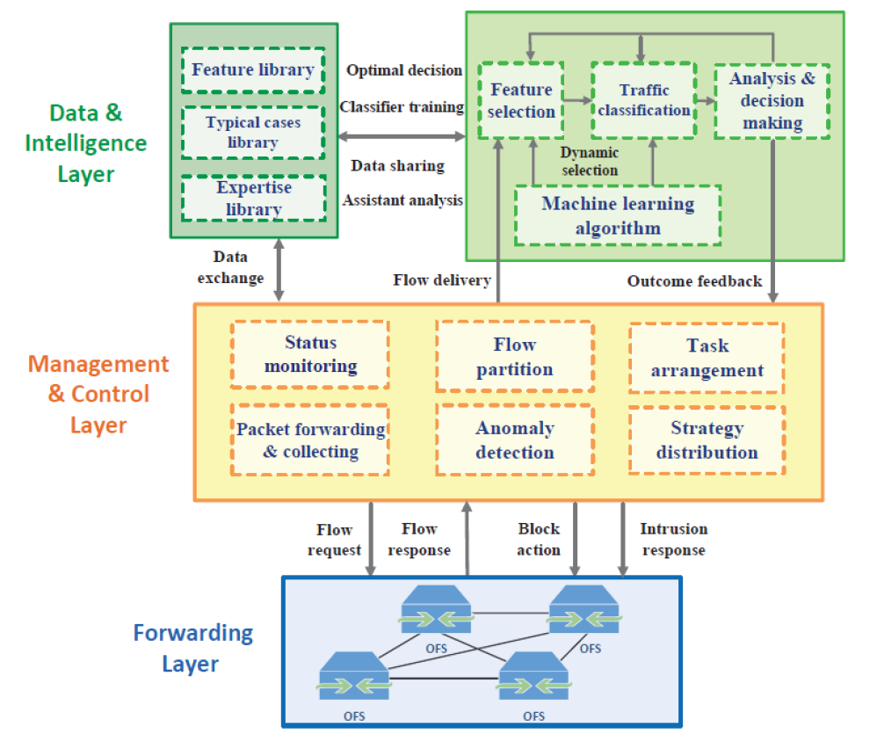
The intrusion detection system

Slide 9
The intrusion detection system
The architecture of the system consists of three layers: the data traffic forwarding layer, the data management and control layer, and the machine learning-based data analysis layer. The data forwarding layer is responsible for the data traffic monitoring and capturing. It can collect and send the suspect data streams to the control layer, and it also blocks the malicious data traffic according to the instructions of the controller. The data management and control layer identifies the suspicious data patterns, and detects anomalies using the analyzed intercepted data. It also takes proper protection measures according to the decisions made by the data analysis layer, and it consequently instructs the data forwarding layer.

Slide 10
The intrusion detection system
The data forwarding layer provides the data management and control layer with real-time network status information through the real-time collection of suspect data patterns. Furthermore, intrusions are immediately blocked by dropping the malicious packets under the supervision of the other system layers.
The packet collection and data flow partitioning layer provides a more global view of the entire 5G network. The status monitoring module supervises the data network status and continuously analyzes the data packets that it receives in order to analyze them. The data management and control layer processes and parses the received data traffic. Furthermore, it creates relevant clusters of data packets and generates a data fingerprint, which keeps track of the following logical network parameters: the source IP address, the destination IP address, the source port, the destination port, the session duration, and the considered network protocol.

Slide 11
The intrusion detection system
The data fingerprints are used in order to define and label different data flow records, which represent specific network connections and activities. The packet collection and inspection is performed continuously. The data collection and inspection time interval is optimized in order to avoid possible undesirable delays concerning the real-time data analysis process. The anomaly detection considers some basic flow statistics, which are used to roughly recognize abnormal behaviors and potential anomalies. The particular intrusion detection system’s module applies an entropy-based analysis, which is based on the Shannon’s theory in order to detect the distribution variations of the analysed data packet samples.

Slide 12
The intrusion detection system
The entropy of a random variable x is computed considering the following formula:

Slide 13
The intrusion detection system
Here, p(x_{i}) designates the probability for x to take the value x_{i} considering all the already detected values. The equation considers four fundamental parameters: the source IP address, the source port, the destination IP address, and the destination port. The values of these parameters are gathered by the real-time traffic analysis component of the system. Thus, considering a particular moment in time, the continuously updated value that the entropy function H(x) provides helps to detect possible malicious data traffic patterns. Considering that E stands for the mean entropy, and S represents the corresponding standard deviation, a possible suspect pattern involves that the value of H(X) is outside the interval [(E-S),(E+S)]. Consequently, the suspect data packets are sent over to the proactive data analysis layer for supplementary analysis.

Slide 14
The intrusion detection system
The feature selection component is designed in order to construct and update the features set, which is specific to the detected malicious data patterns. This component is capable to process large amounts of data in a real-time fashion, while removing the data features that are irrelevant to the machine learning core of the system’s proactive data analysis layer. Consequently, the data is partitioned into relevant categories, so that malicious data traffic patterns are clearly separated from the benign traffic patterns.
The feature selection component is designed in order to construct and update the features set, which is specific to the detected malicious data patterns. This component is capable to process large amounts of data in a real-time fashion, while removing the data features that are irrelevant to the machine learning core of the system’s proactive data analysis layer. Consequently, the data is partitioned into relevant categories, so that malicious data traffic patterns are clearly separated from the benign traffic patterns.

Slide 15
Performance assessment
The performance analysis considers the data that was effectively gathered during the real-time intrusion detection process on the provider’s 5G data network. The dataset that was considered for the performance assessment contains 32,000,000 analyzed network connections. Each individual connection entity consists of 39 features that are separated into three categories. Thus, the system considers network connections-based features, content-based features, and data traffic-based features. Furthermore, each data traffic entity is marked either as a normal traffic entity, or as a suspicious traffic entity. The latter ones are grouped into four distinct categories: remote to local, probe, user to root, and denial of service.

Slide 16
Performance assessment
The performance assessment considers the following metrics: precision (P), reliability (R), tradeoff (T), accuracy (A), and the false positives rate (FP). The precision is defined as the percentage of valid malicious data traffic predictions relative to the total number of predictions that the intrusion detection system makes. The reliability is calculated as the total number of accurately determined intrusion attempts relative to the total number of intrusions. Furthermore, the tradeoff represents a hybrid performance metric between the precision and the reliability, which has the role to provide a better accuracy of the data classification through the following formula: T = 2/((1/P)+(1/R))

Slide 17
Performance assessment
The accuracy is a ratio that is determined by the sum of the number of legitimate packets and malicious packets properly detected at the numerator, while the denominator is the sum of the accurately detected legitimate and malicious packets plus the incorrectly detected legitimate and malicious packets. Moreover, the false positives rate is determined by the number of legitimate packets that are incorrectly classified over the sum between properly classified legitimate packets and incorrectly classified legitimate packets.

Slide 18
Performance assessment

Slide 19
conclusions
The system scales well with the size of the analyzed data set. Furthermore, the system is able to accurately determine the malicious traffic patterns, while reducing to the minimum the incidence of the false positives. The practical behaviour of the system is especially important in the case of commercial 5G data networks, which transport and process a large number of data transfer sessions that have to be analyzed in a proactive manner.
The 5G data networks already support relevant real-world applications, and they have the potential to become the backbone of the future always connected human society. Consequently, there are rather difficult design, implementation and deployment problems, which concern all aspects of the 5G networks. Among them, the timely detection of any illegitimate access attempt is essential, especially in the context of a commercial data network. Therefore, this paper presents the state-of-the-art concerning the research that has been made on this very important topic. Furthermore, a real-time intrusion detection system, which is based on the utilization of machine learning techniques, is described.

Slide 20
conclusions
The performance of the system has been tested using real-world data, which has been obtained through the real-time monitoring of the 5G data traffic on the network of a significant Romanian telecommunications services provider. This assessment demonstrates that it is possible to design a software system that blocks most of the illegitimate traffic, which occurs on a high-traffic 5G data network, in a real-time fashion. Moreover, the various existing contributions, which are relevant to the approached topic, are presented in a constructive analytical manner, while the problems that have to be addressed are analyzed, and possible solutions are suggested for their resolution.

